Slide 1

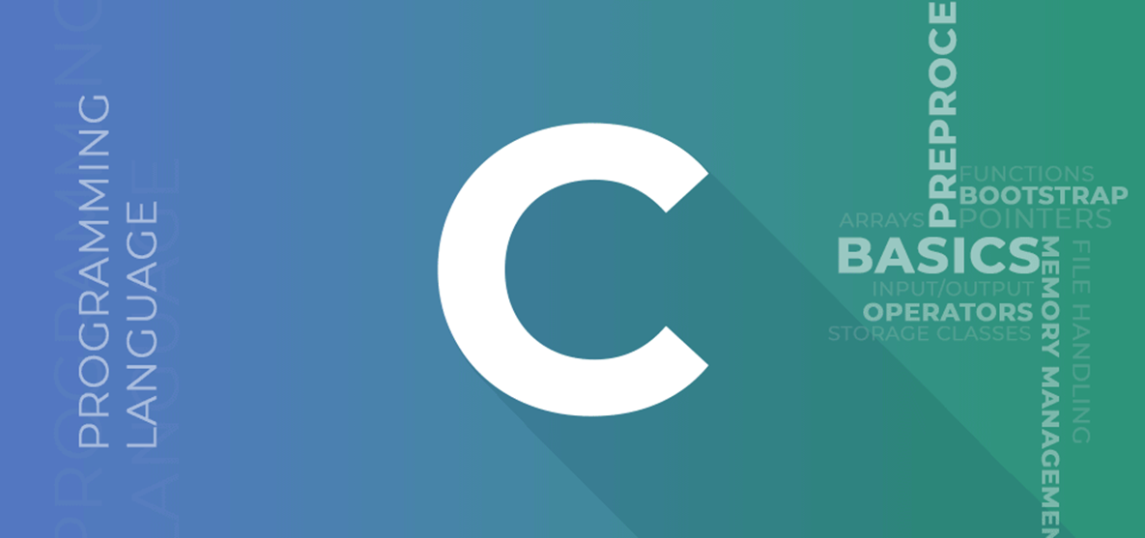




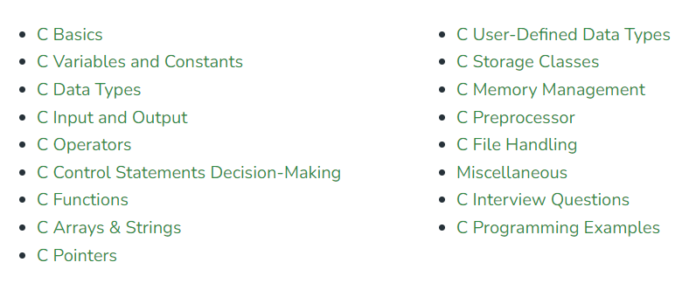

Master C programming With Examples
Youtube @ramjilal4you
00
By Ramjilal Meena
Basic → Advance
Complete C Programming

Slide 2
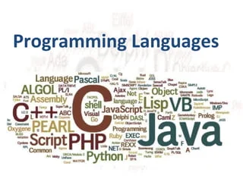
Computer Program & Programming Languages
01
By @ramjilal4you

Slide 3
Program & Programming Language?
A sequence or set of instructions in a programming language for a computer to execute.
Need a specific language to communicate with human or computer.
A programming language is a set of instructions written in a specific language to perform a specific task. It is mainly used to develop desktop applications, operating systems, websites, mobile applications, etc.
Types of programming languages
Low-level language - Close to hardware
High-level language - Close to Humans
Middle-level language - Intermediate

Slide 4
Low-level language
Machine-dependent.
Based on the binary number 0’s and 1’s.
The processor runs low-level programs directly without the need of a compiler or interpreter so the program written in low-level language can be run very fast.
Not portable.
Low-level language is further divided into two parts
Machine Language
Also called machine code or object code.
Difficult to read and write.
Does not require a translator to convert the programs because computers directly understand the machine language programs
Assembly Language
Assembly language is designed for specific processors.
It represents the set of instructions in a symbolic and human-understandable form.
It uses an assembler to convert the assembly language to machine language.

Slide 5
High-level language
Designed for developing user-friendly software programs and websites.
Requires a compiler or interpreter to translate the program into machine language (execute the program).
Example: Python, Java, JavaScript, PHP, C#, C++, etc.
A high-level language is further divided into three parts -
Procedural Oriented programming language
Derived from structured programming and based upon the procedure call concept.
It divides a program into small procedures called routines or functions.
Example: C, FORTRAN, Basic, Pascal, etc.
Object-Oriented Programming language
Based upon the objects & classes.
Programs are divided into small parts called objects.
It is used to implement real-world entities like inheritance, polymorphism, abstraction, etc in the program to make the program reusable, efficient, and easy to use.
Example: C++, Java, Python, C#, etc.
Natural language
Natural language is a part of human languages such as English, Russian, German, and Japanese.
It is used by machines to understand, manipulate, and interpret human language.

Slide 6
Middle-level programming language
MLL lies between the low-level programming language and the high-level programming language.
It is also known as the intermediate programming language and pseudo-language.
Advantages
Supports the features of high-level programming
User-friendly language
Closely related to machine language and human language.
Example: C, C++, language

Slide 7
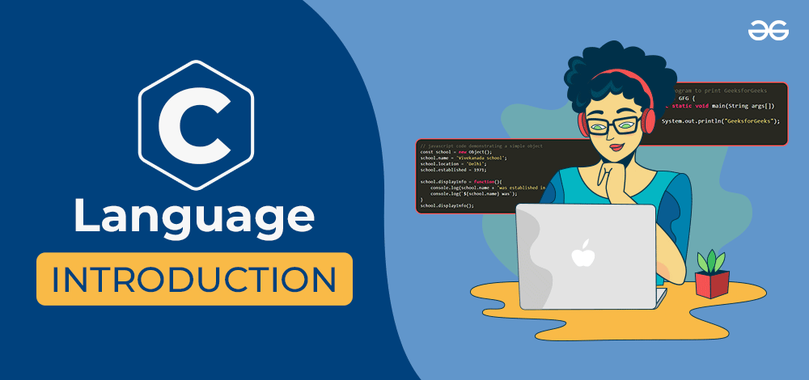
Next Video : C Language Introductoin

Slide 8

Thank You
Please Like, Subscribe and Comment.

Slide 9
Introduction to C Programming Languages
02
By @ramjilal4you

Slide 10

Last Video : Programming Language

Slide 11

C Language Introduction
A procedural programming language
Developed by Dennis Ritchie in the year 1972 at Bell Laboratories.
It was mainly developed as a system programming language to write the UNIX operating system.

Slide 12
The main features of the C language
General Purpose and Portable
Low-level Memory Access
Fast Speed
Clean Syntax

Slide 13
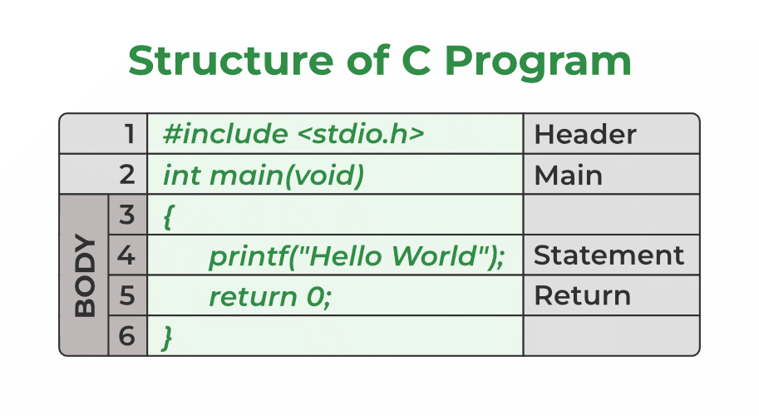
Writing the First Program in C

Slide 14


Slide 15
Why Should We Learn C?
C is a Middle-Level Language - C reduces the gap between the low-level and high-level languages.
Fewer Libraries so easy to learn.
Helps to understand the fundamentals of Computer Theories. E.g. Computer Networks, Compiler Designing, Computer Architecture, Operating Systems.
Helps to understand a lot of underlying architecture of operating system. Like, pointers, working with memory locations etc.
C is very fast in terms of execution time – very fast in terms of execution as it does not have any additional processing overheads such as garbage collection or preventing memory leaks etc.
Embedded Programming - C is widely used in developing firmware, middleware, and operating systems, making it a crucial language in the embedded software industry
Many real-time operating systems (RTOS) are written in C, making it an essential skill for developers working in this field.

Slide 16
Application of C
Operating systems: C is widely used for developing operating systems such as Unix, Linux, and Windows.
Embedded systems: C is a popular language for developing embedded systems such as microcontrollers, microprocessors, and other electronic devices.
System software: C is used for developing system software such as device drivers, compilers, and assemblers.
Networking: C is widely used for developing networking applications such as web servers, network protocols, and network drivers.
Database systems: C is used for developing database systems such as Oracle, MySQL, and PostgreSQL.
Gaming: C is often used for developing computer games due to its ability to handle low-level hardware interactions.
Artificial Intelligence: C is used for developing artificial intelligence and machine learning applications such as neural networks and deep learning algorithms.
Scientific applications: C is used for developing scientific applications such as simulation software and numerical analysis tools.
Financial applications: C is used for developing financial applications such as stock market analysis and trading systems.
C is one of the most widely used programming language.

Slide 17
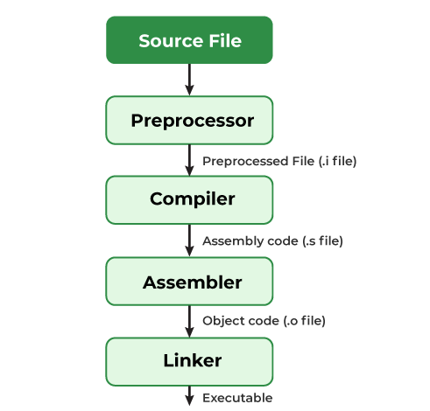
Compiling a C Program: Behind the Scenes
Next : Video…

Slide 18
Thank You
Please Like, Subscribe and Comment.

Slide 19
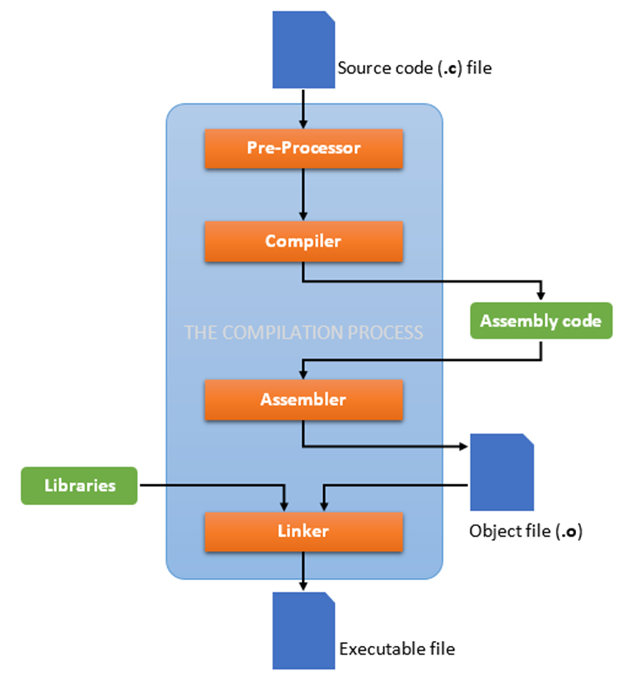
Compiling a C Program: Behind the Scenes
03
By @ramjilal4you

Slide 20

Last Video : C Language Introductoin

Slide 21
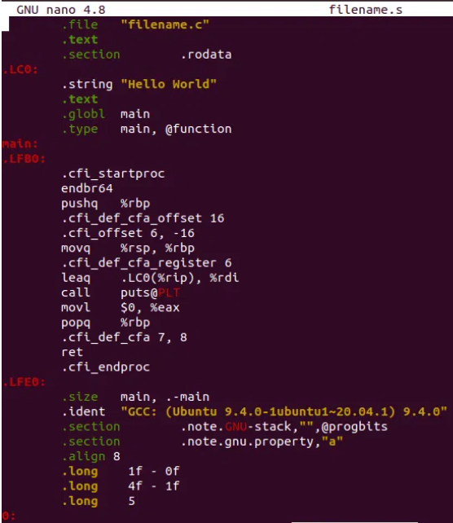
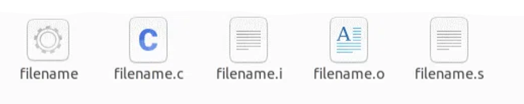
How do we compile and run a C program?
Need a compiler and a code editor to compile and run a C Program
Process of converting source code into machine code.
Source File –> filename.c
Pre-processing –> filename.i
Removal of Comments.
Expansion of Macros.
Expansion of the included files.
Conditional compilation.
Compiling –> filename.s
produce an intermediate compiled output.
output file is in assembly-level instructions.
Assembling –> filename.o
This file contains machine-level instructions.
Existing code is converted into machine code.
The function calls like printf() are not resolved.
Linking –> filename.exe / filename
Linking of function calls with their definitions.
Linker adds some extra code, required when the program starts and ends.

Slide 22
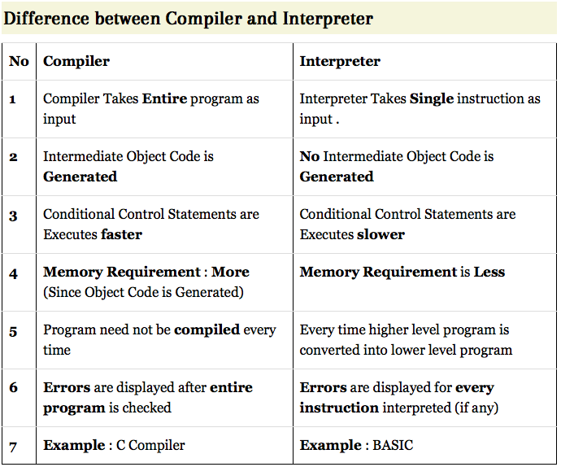
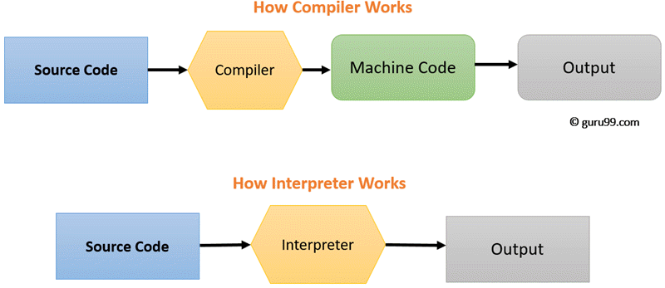
Compiler Vs Interpreter
Interpreters and Compilers convert the Source Code (HLL) to Machine Code (understandable by Computer)

Slide 23
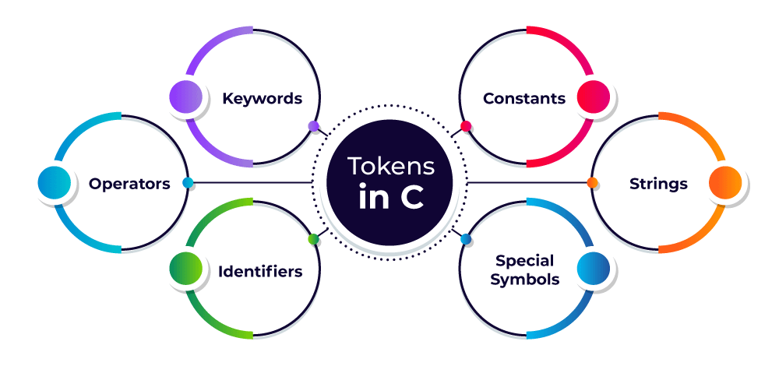
Next Video: Tokens & Comments in C

Slide 24
Thank You
Please Like, Subscribe and Comment.

Slide 25
Tokens & Comments in C
04
By @ramjilal4you

Slide 26
Last Video : Compiling a C Program: Behind the Scenes

Slide 27

Tokens
Smallest individual element of the C programming language that is meaningful to the compiler.
It is the basic component of a C program.

Slide 28
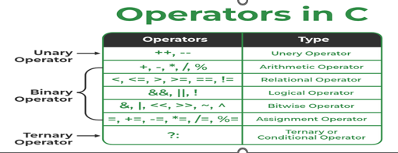
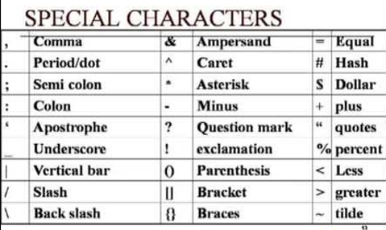
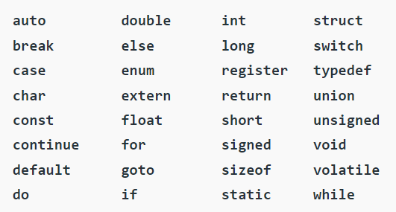
Keywords
Rules for Naming Identifiers
Must begin with a letter or underscore(_)
Must consist of only letters, digits, or underscore
Should not be a keyword.
Must not contain white space.
Max 31 characters long as only the first 31 characters are significant.
Constants
Strings
char string[20] = {‘h’, ’e’, ‘l’, ‘l’, ‘o’, ‘\0’};
char string[20] = “hello”;
char string [] = “hello”;
const int c_var = 20;
const int* const ptr = &c_var;

Slide 29
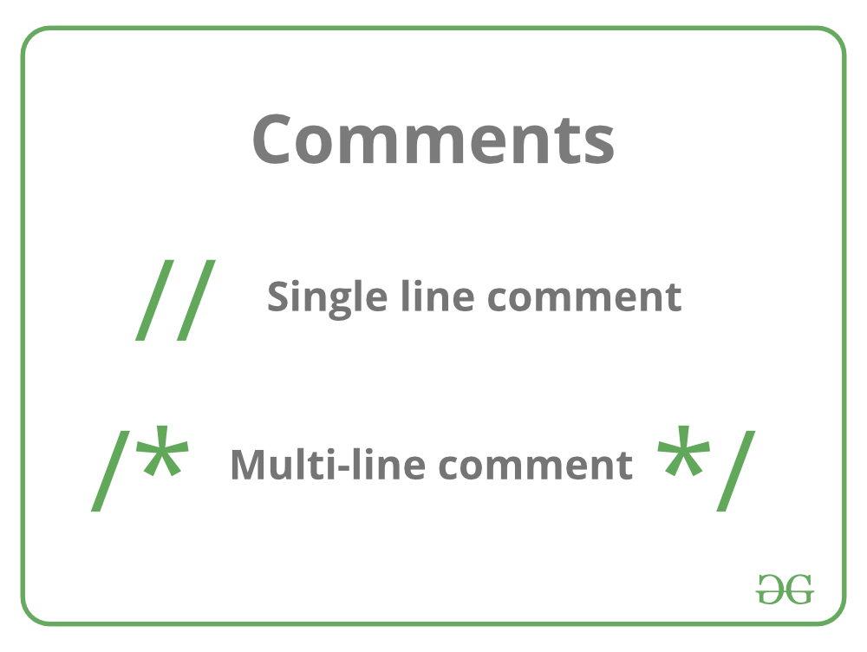
Comments in C
Single-line comment
Multi-line comment
/* C program to illustrate use
of multi-line comment */
#include <stdio.h>
int main(void)
{
// This is a single line comment
printf(“Hello World !");
return 0;
}

Slide 30
When & Why to use Comments in C programming?
A person reading a large code will be bemused if comments are not provided about details of the program.
C Comments are a way to make a code more readable by providing more descriptions.
C Comments can include a description of an algorithm to make code understandable.
C Comments can be used to prevent the execution of some parts of the code.

Slide 31
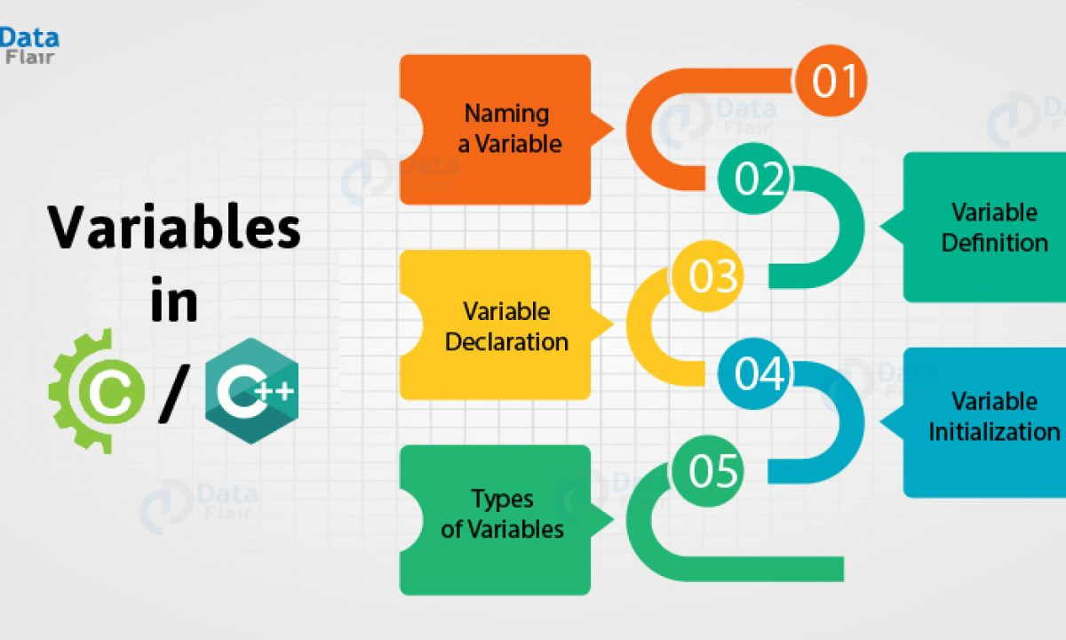
Next Video: Variables in C

Slide 32
Thank You
Please Like, Subscribe and Comment.

Slide 33
Variables in C
05
By @ramjilal4you

Slide 34
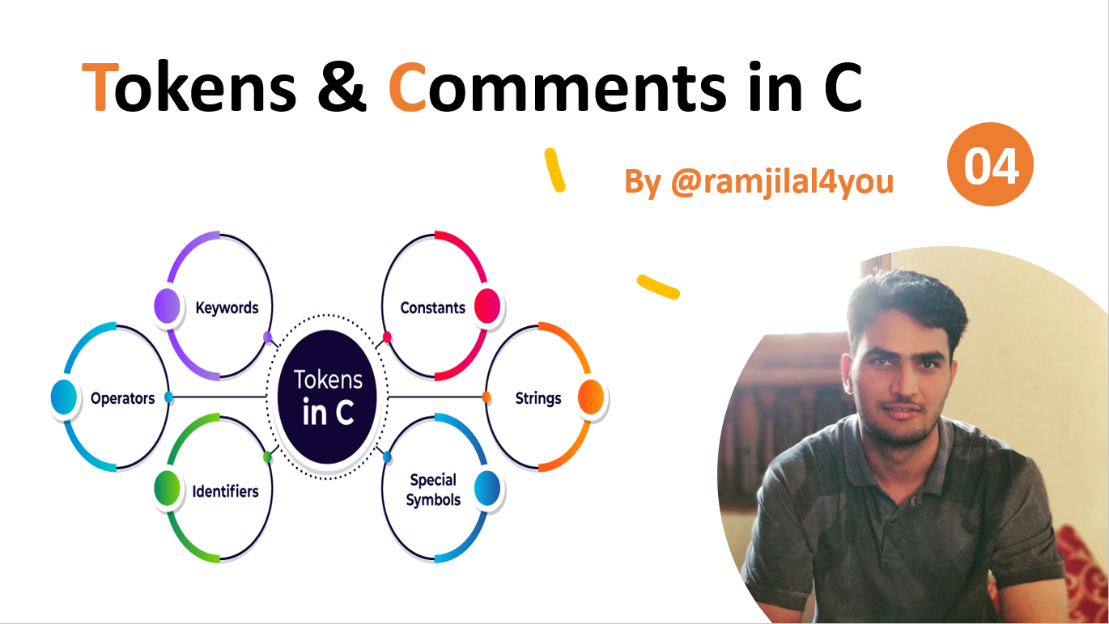
Last Video:

Slide 35
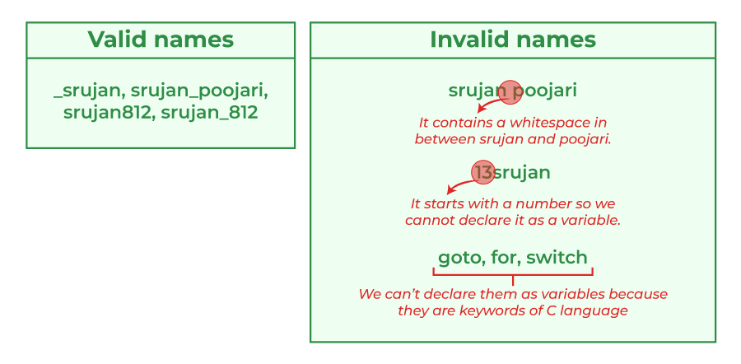
Variables in C is a memory location with some name that helps store some form of data and retrieves it when required.
Rules for Naming Variables
alphabets, digits & underscore.
start with an alphabet or an underscore.
No whitespace is allowed.
Keywords not allowed.

Slide 36
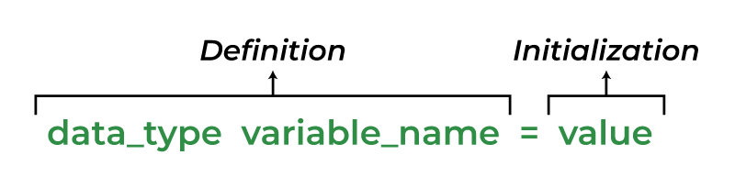
Variables in C
There are 3 aspects of defining a variable:
Declaration – Only existence, No memory is allocated.
Definition – Memory allocation with some value.
Initialization – Assigning some value.

Slide 37
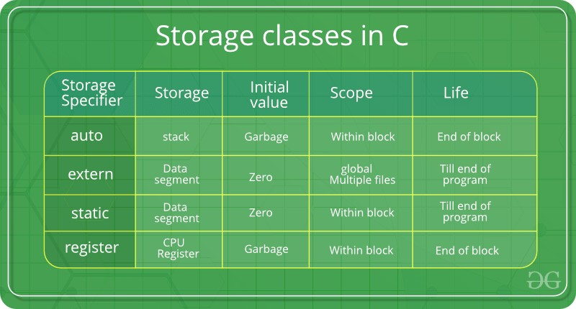
Types of Variables in C depending on the scope, storage class, lifetime, type of data they store
Local Variables
Global Variables
Automatic Variables
Extern Variables
Static Variables
Register Variables
7. Constant Variables

Slide 38
Hands on Example

Slide 39
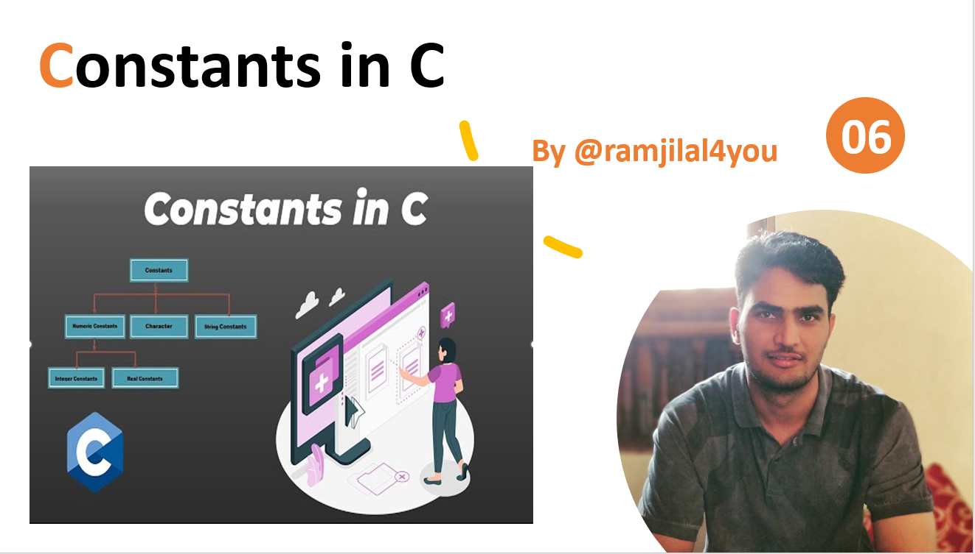
Next Video:

Slide 40
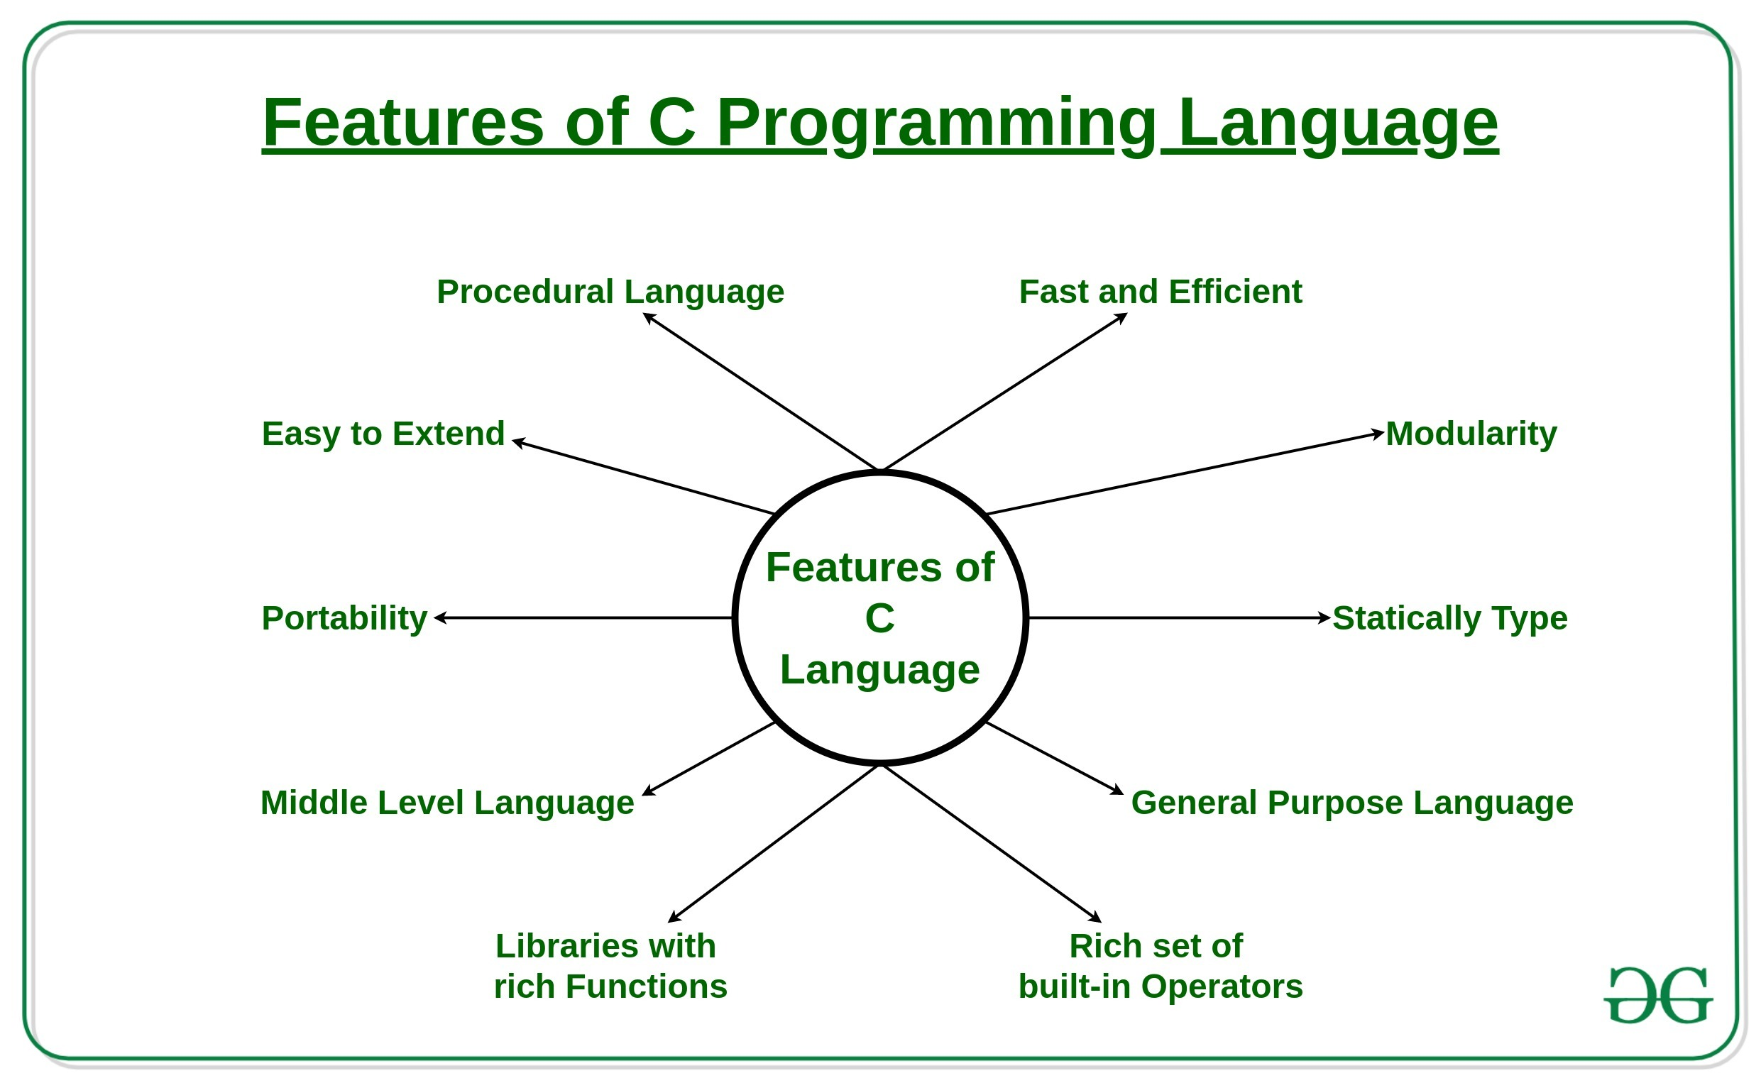
Features of C Programming Language
By @ramjilal4you

Slide 41
Features of C Programming Language
low-level access to memory, a simple set of keywords, & a clean style,
system programming, OS or compiler development.
Procedural, Dennis Ritchie, 1972
Procedural Language – step by step, instruction, multiple fun(), other- OOP
Fast and Efficient – direct manipulation, computer hardware, less feature
Modularity – libraries, future uses, power
Statically Type – variable type checked at compilation
General Purpose Language – common & various applications – OS, DBS
Rich set of built-in Operators – Unary, Binary, ternary
Libraries with Rich Functions – Robust libraries and functions
Middle-Level Language – low & High level features
Portability – run and compile on any system.
Easy to Extend – some more features & operations can be added.

Slide 42
Thank You
Please Like, Subscribe and Comment.

Slide 43
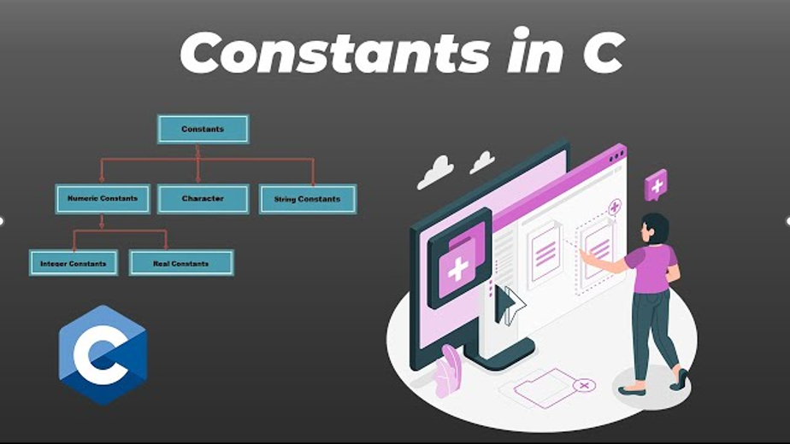
Constants in C
06
By @ramjilal4you

Slide 44
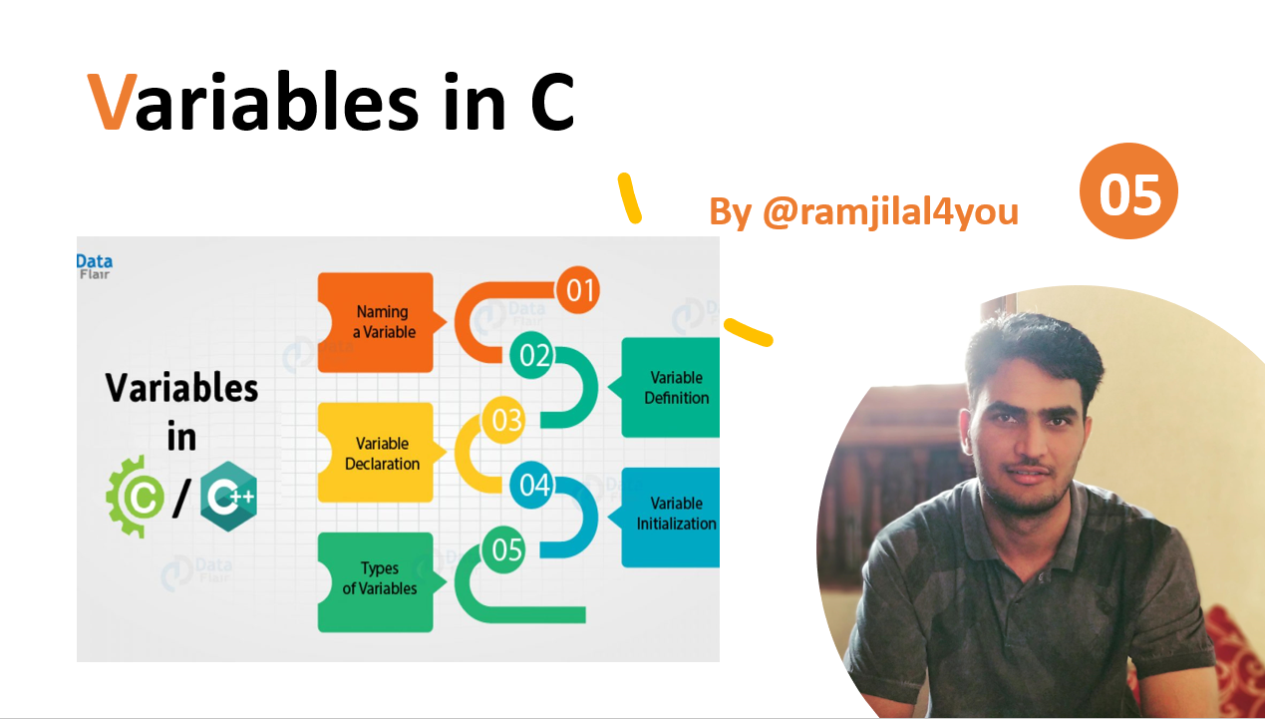
Last Video:

Slide 45
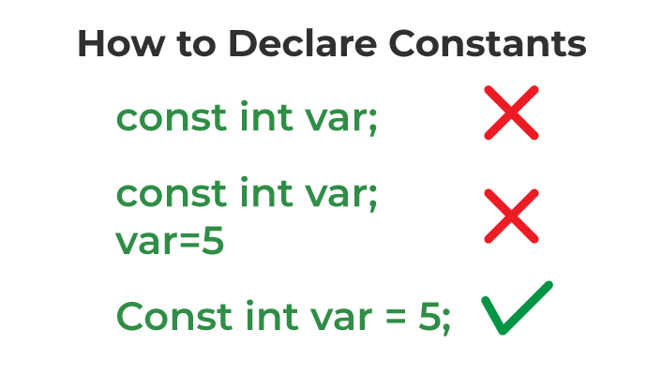
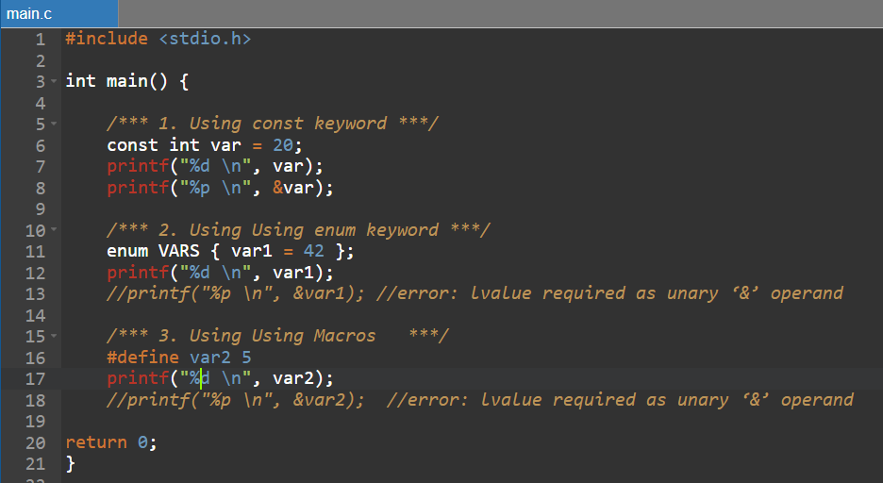
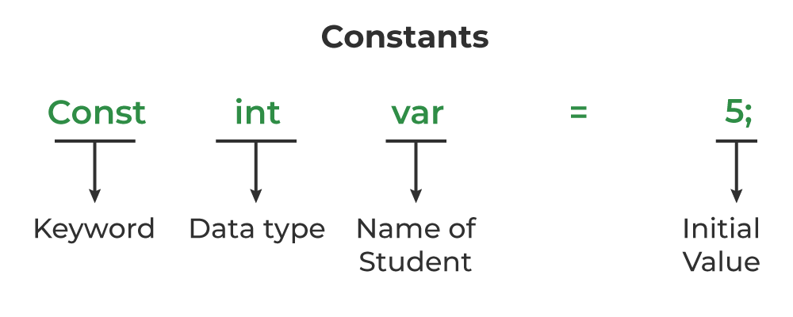
Constants in C
Is there any way to change the value of a constant variable in C?

Slide 46
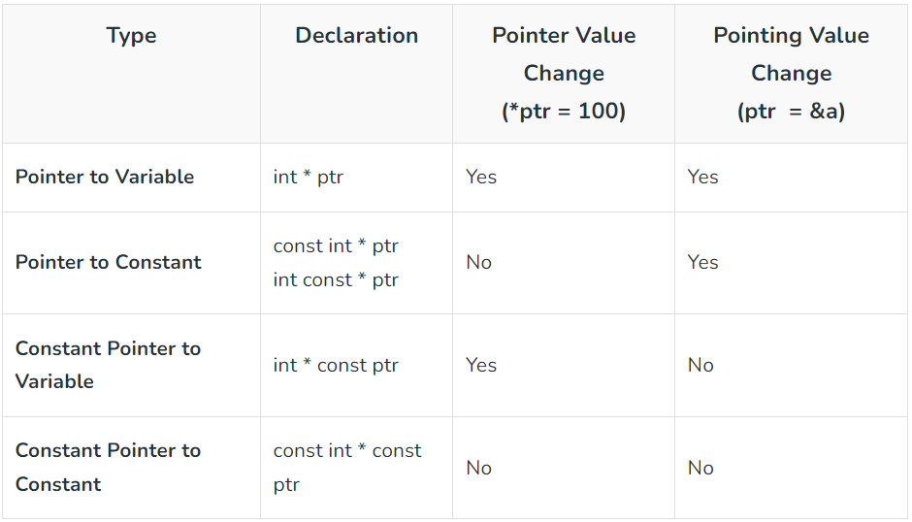
Advantages of const Qualifier
Improved Code Readability
Enhanced Type Safety
Improved Optimization
Better Memory Usage
Improved Compatibility
Improved Reliability

Slide 47
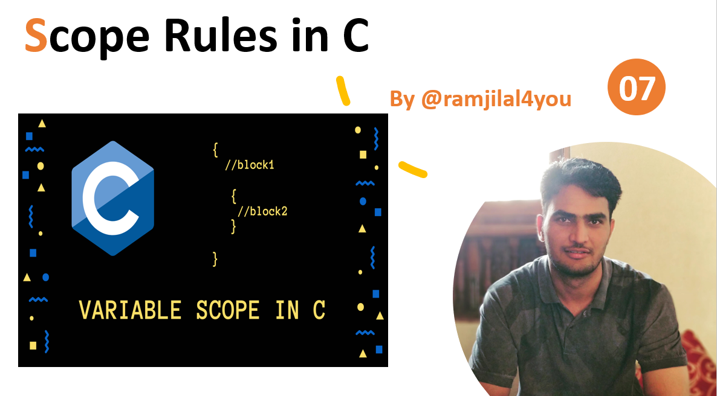
Next Video:

Slide 48
Thank You
Please Like, Subscribe and Comment.

Slide 49
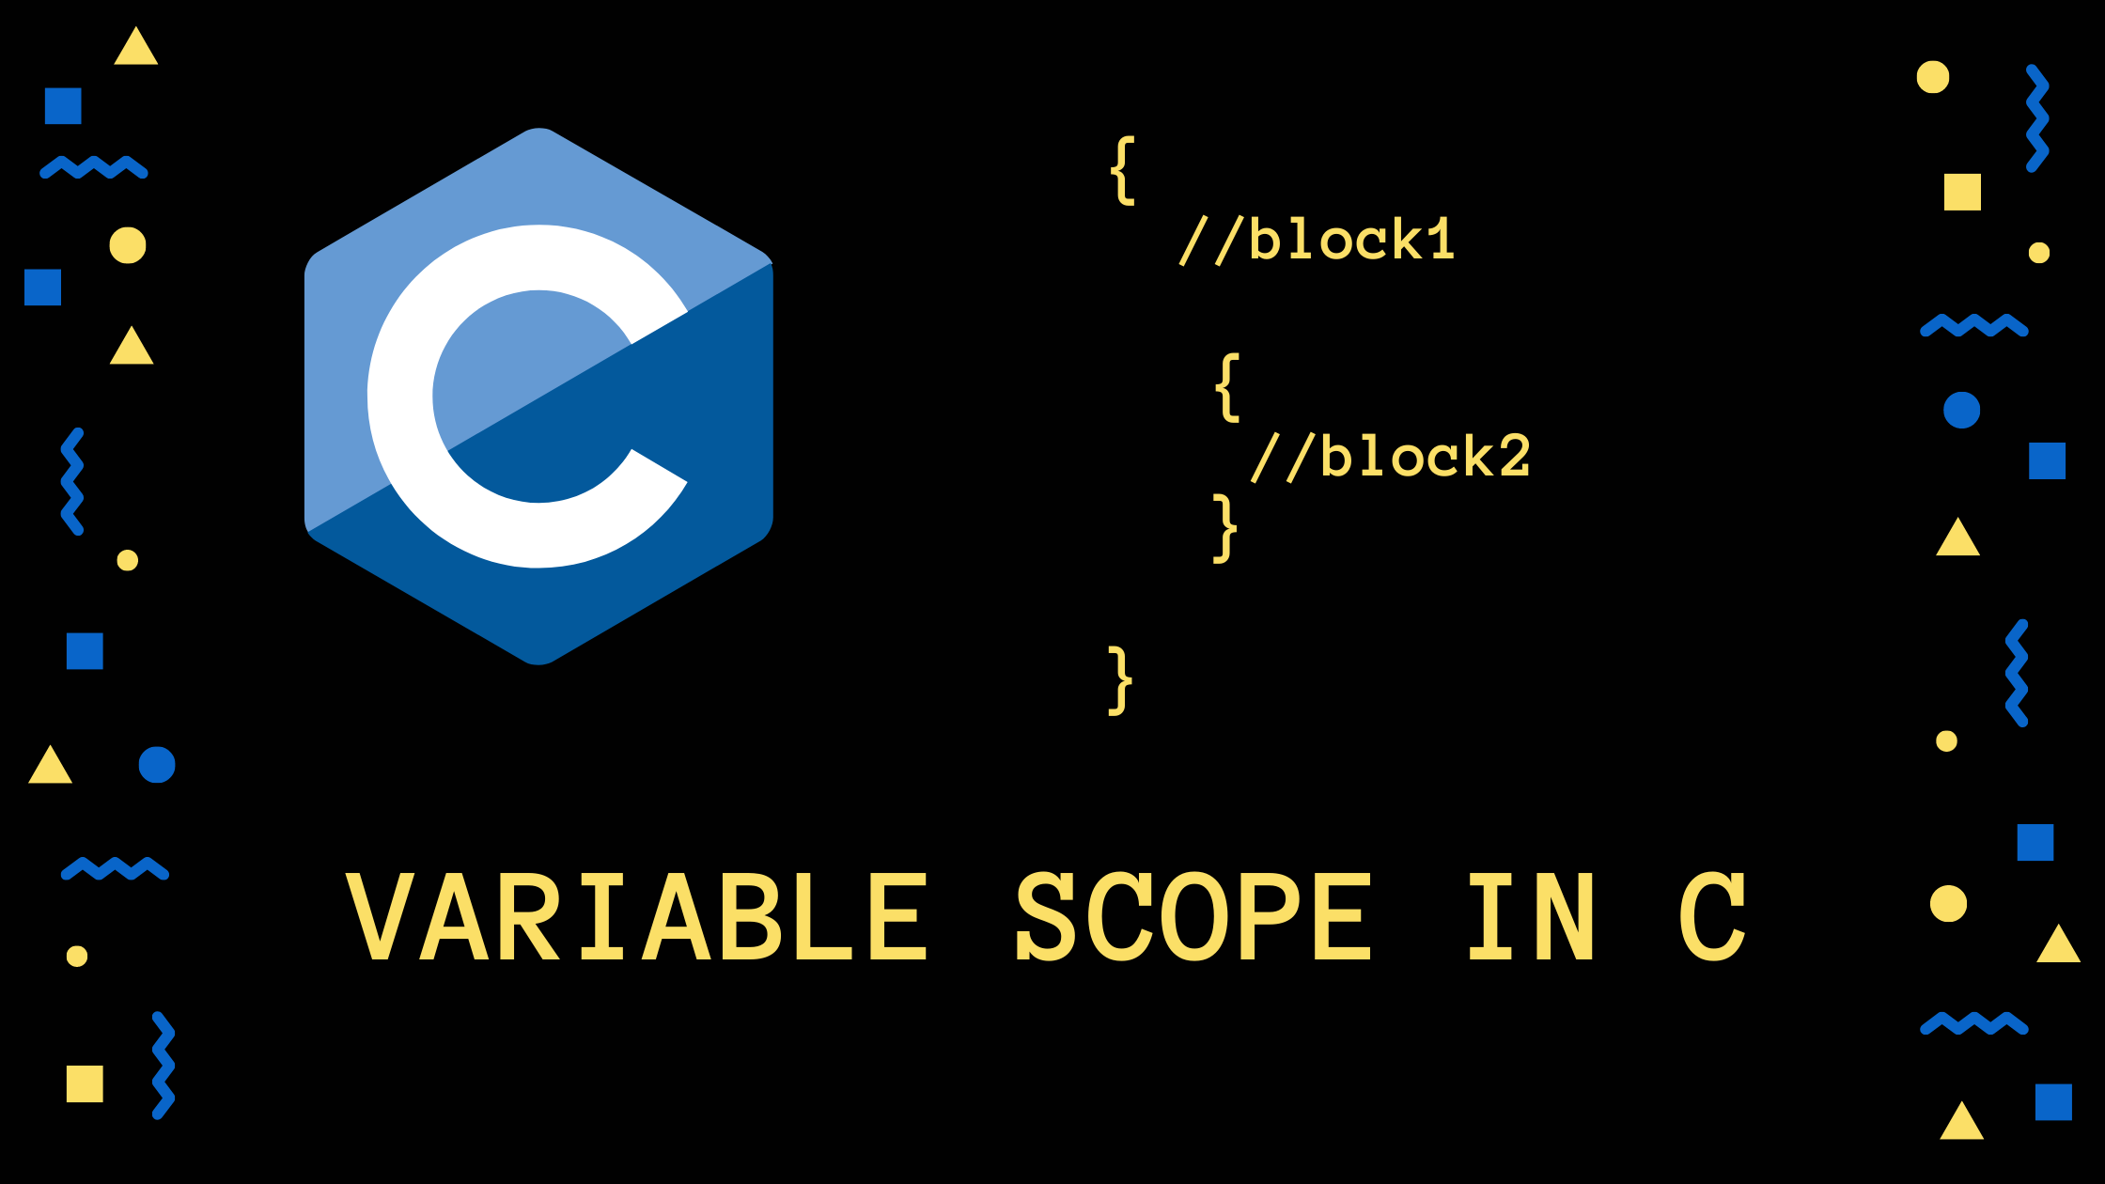
Scope Rules in C
07
By @ramjilal4you

Slide 50
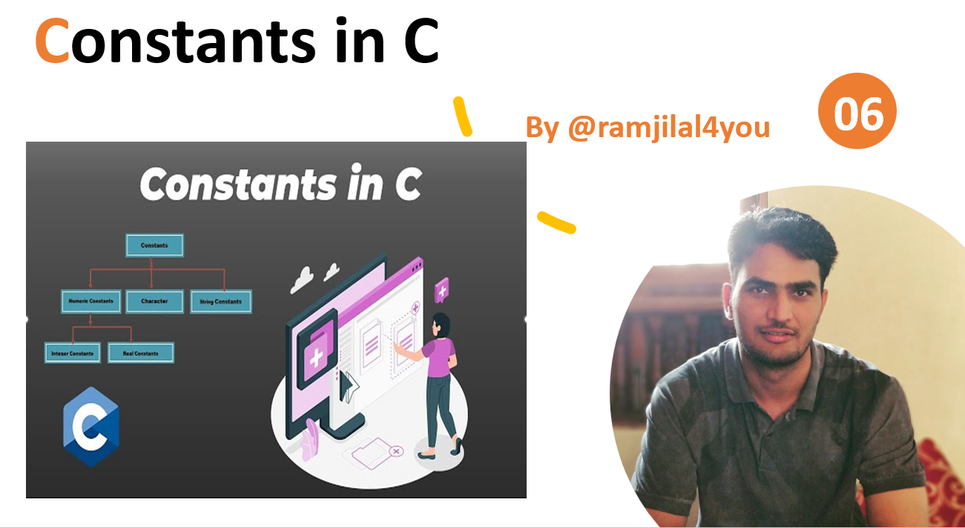
Last Video:

Slide 51
Scope rules in C
The scope is the area under which a variable is visible.
The scope of an identifier is the part of the program where the identifier may directly be accessible.
We can only refer to a variable in its scope.
In C, all identifiers are lexically(or statically) scoped.

Slide 52
Types of Scope Rules in C
Global Scope in C
Refers to the region outside any block or function.
Declared in the global scope are called global variables.
Visible in every part of the program.
Also called File Scope as the scope of an identifier starts at the beginning of the file and ends at the end of the file.
Local Scope in C
Declared within the local scope are called local variables.
Visible in the block they are declared in and all inner blocks.
Also called Block scope.
Local variables have internal linkage.

Slide 53
FAQs on Scope Rules in C
Q1. What if the inner block itself has one variable with the same name?
Answer: If an inner block declares a variable with the same name as the variable declared by the outer block,
then the visibility of the outer block variable ends at the point of the declaration by inner block.
Q2. What is the difference between the scope and lifetime?
Answer: The scope and lifetime of a variable are often confused with one another
The scope of the variable is the region where it is valid to refer to the variable using its name.
The lifetime of the variable is the time between it is allocated memory and it is deleted from the memory.
Q2. What about functions and parameters passed to functions?
Answer: A function itself is a block. Parameters and other local variables of a function follow the same block scope rules.
Q3. Can variables of the block be accessed in another subsequent block?
Answer: No, a variable declared in a block can only be accessed inside the block and all inner blocks of this block.
Q4. How to Access Global Variable if there is a Local Variable with Same Name in C/ C++?
Answer: 1. Using extern, 2. using Scope resolution operator (::)

Slide 54
Hands on Example
Scope Rules in C

Slide 55
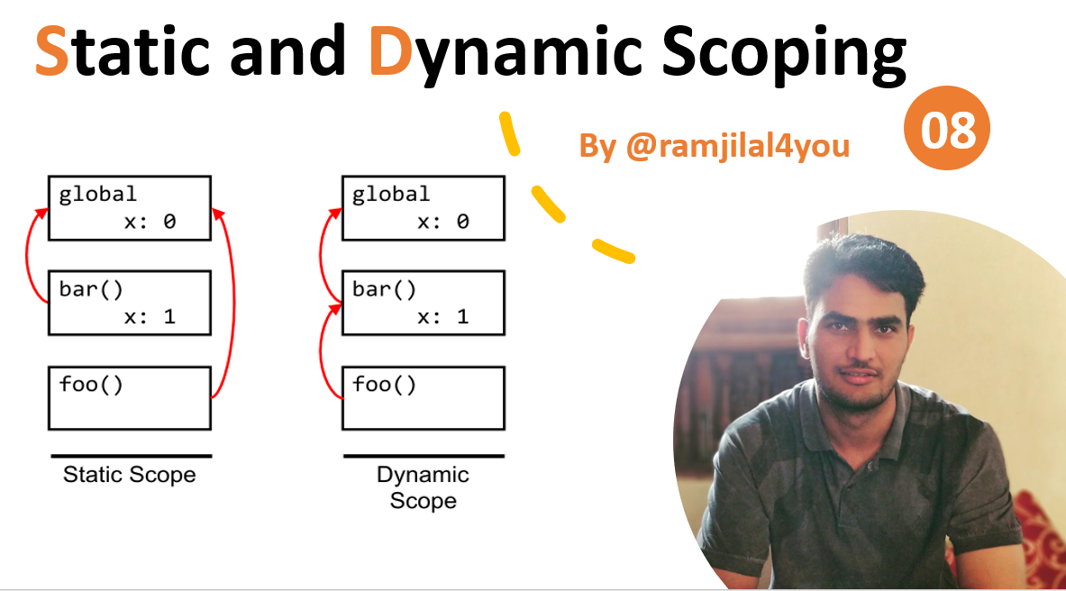
Next Video:

Slide 56
Thank You
Please Like, Subscribe and Comment.

Slide 57
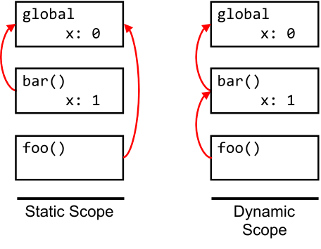
Static and Dynamic Scoping
08
By @ramjilal4you

Slide 58

Last Video:

Slide 59
Static and Dynamic Scoping
Static Scoping
Static scoping is also called lexical scoping
a variable always refers to its top-level environment.
compiler first searches in the current block, then in global variables, then in successively smaller scopes.
E.g. C, C++, and Java.
Dynamic Scoping
compiler first searches the current block and then successively all the calling functions.
Dynamic scoping does not care about how the code is written, but instead how it executes
Each time a new function is executed, a new scope is pushed onto the stack.
E.g. Perl.

Slide 60
Static Scoping
Dynamic Scoping
Advantages:
Easy to understand, because it is determined at compile-time.
Faster execution, no need of runtime lookups, Improve program performance.
Less error-prone.
Optimize the code by eliminating unnecessary variable lookups.
Program maintenance & debugging less time-consuming and less error-prone.
Disadvantages:
Scope of variables can be less flexible.
Harder to write code that is reusable, because variables can only be accessed within their defined scope.
Not well-suited for implementing dynamic features such as dynamic scoping or closures.
Lead to namespace collisions, where variables in different scopes have the same name, leading to confusion and errors.
Advantages:
More flexible, because variables can be accessed from any part of the program.
Easier to write code that is reusable, because variables can be accessed from anywhere.
Dynamic scoping can make it easier to debug certain types of code, such as recursive functions or code with complex control flow.
It allows code to adapt more easily to changing requirements or circumstances.
Disadvantages:
Difficult to understand, because it is determined at runtime.
Slower execution , requires additional lookups.
More error-prone because variables can be accessed from unexpected places.

Slide 61
Hands on Example
Static and Dynamic Scoping

Slide 62
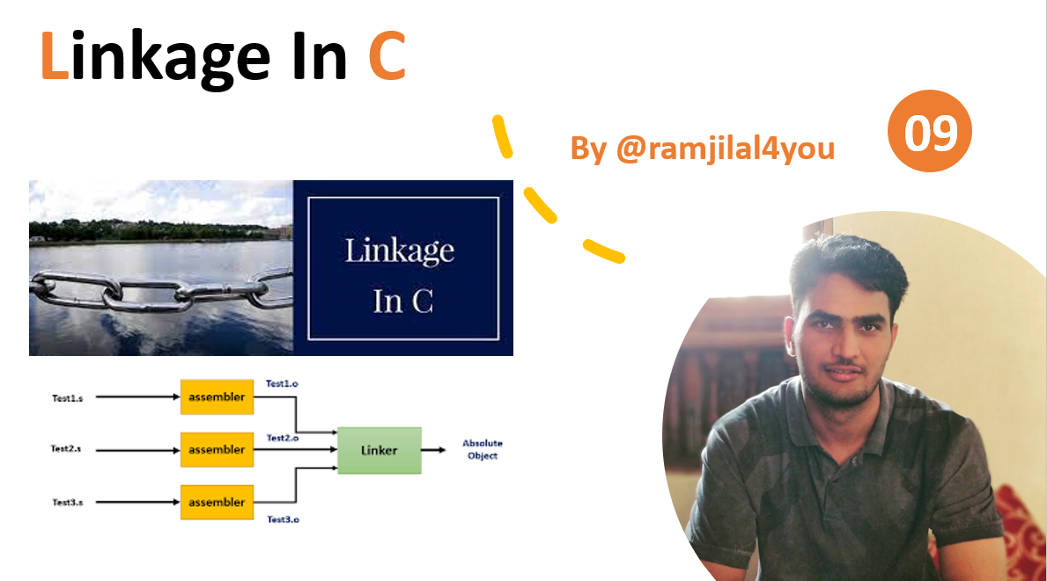
Next Video:

Slide 63
Thank You
Please Like, Subscribe and Comment.

Slide 64

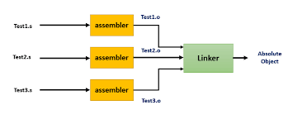
Linkage In C
09
By @ramjilal4you

Slide 65
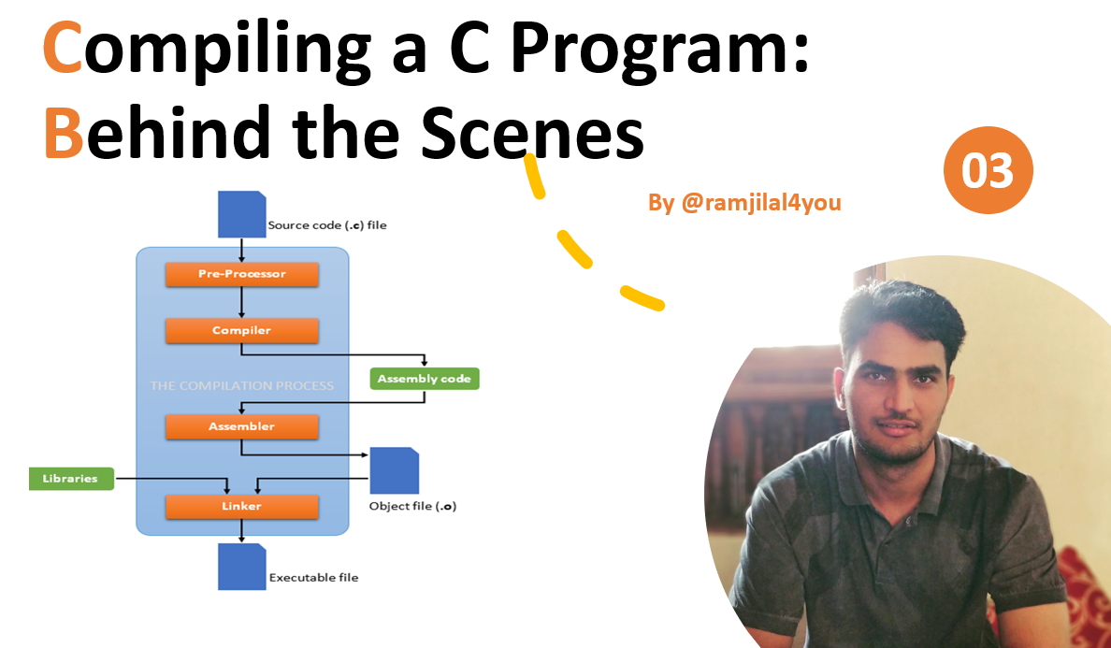
Last Videos:

Slide 66
What is Linkage in C?
Scope : Visibility or Accessibility of an Identifier.
scope is a property handled by compiler, whereas linkage is a property handled by linker.
Translation Unit : a file containing source code, header files and other dependencies.
a basic unit which are independently compliable by the compiler.
Linkage : Linkage is a property of a variable name.
During compilation, Each Translation unit is complied to generate the corresponding object file(*.obj).
During linking time, All object files are processed by linker and generates machine code for application.
The Linker is a program that takes multiple object files as input and produces an executable.
It resolves symbols and arranges objects in address space.

Slide 67

Understanding Linkage in C
There are 3 types of linkage
1. No Linkage
2. Internal linkage
3. External linkage

Slide 68
Understanding Linkage in C
No Linkage
Names not specified with external, or internal linkage also have no linkage.
after compilation, there is no such name(with no linkage) exists in program.
Hands-on Example…

Slide 69
Understanding Linkage in C
Internal linkage
• Here, the name can be referred to from all scopes in the current translation unit.
variables, functions, or function templates declared static
Any identifier within the unit can access an identifier having internal linkage.
Stored in initialized or uninitialized segment of RAM.
Not accessible outside the translation unit it is declared in.
Hands-on Example…

Slide 70
Understanding Linkage in C
External linkage
• Here, the name can be referred to from any translation units.
• Any of the following names declared at namespace scope have
Identifiers declared with extern
Identifiers not declared static,
visible to every translation unit.
Stored in initialized/uninitialized or text segment of RAM
Hands-on Example…

Slide 71
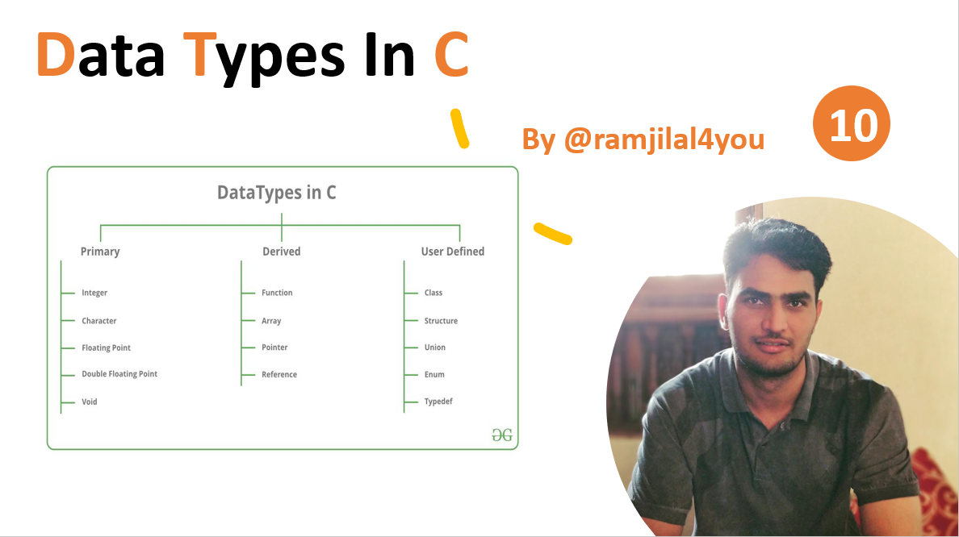
Next Video:

Slide 72
Thank You
Please Like, Subscribe and Comment.

Slide 73
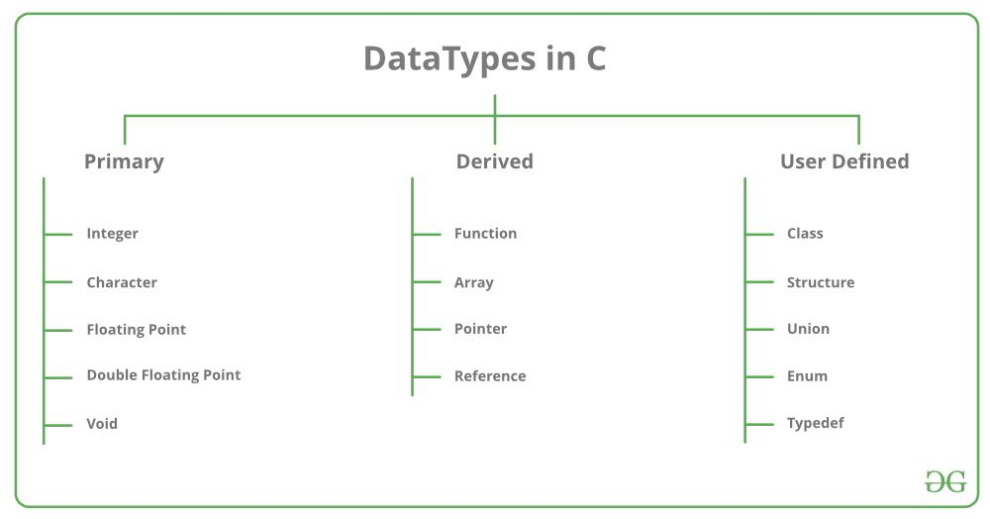
Data Types In C
10
By Ramjilal Meena
Implicit & Explicit Type Conversion
Advantages & Disadvantages
Integer Promotions

Slide 74
Last Videos

Slide 75
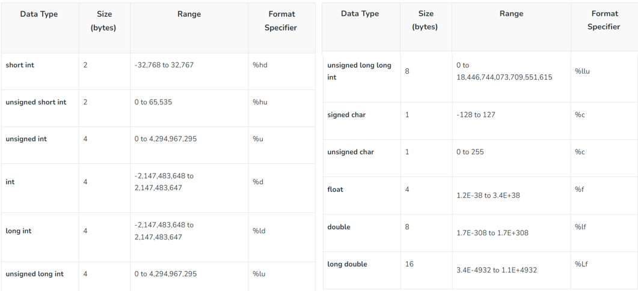
Data Types In C
Each variable in C has an associated data type.
It specifies the type of data that the variable can store like integer, character, floating, etc.
Each data type requires different amounts of memory and has some specific operations which can be performed over it.
Different data types also have different ranges up to which they can store numbers.
These ranges may vary from compiler to compiler.
Hands-on Example…
32-bit GCC compiler-based ranges

Slide 76
Integer Promotions in C
Some data types like char , short int take less number of bytes than int, these data types are automatically promoted to int or unsigned int when an operation is performed on them.
No arithmetic calculation happens on smaller types like char, short and enum.
They are first converted to int or unsigned int, and then arithmetic is done on them.
Hands-on Example…

Slide 77
Type Conversion in C
Type conversion in C is the process of converting one data type to another.
Type conversion is performed by a compiler.
The destination data type can’t be smaller than the source data type.
There are two types of Conversion:
Implicit Type Conversion
Explicit Type Conversion
Hands-on Example…

Slide 78
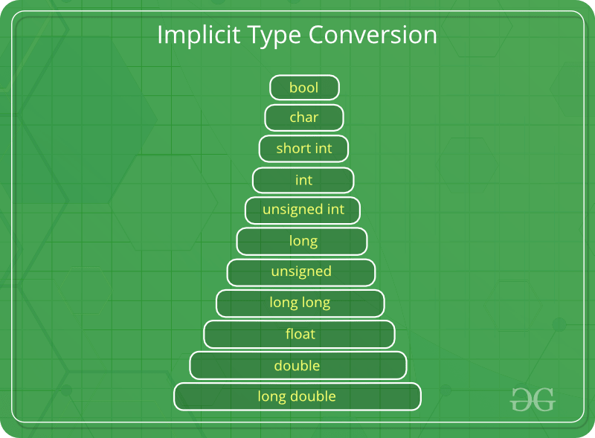
Implicit Type Conversion
Done by the compiler.
more than one data type is present in an expression.
All the data types of the variables are upgraded to the data type of the variable with the largest data type.
Lose information, signs
signed → unsigned
long → float (overflow can occur)
Hands-on Example…

Slide 79
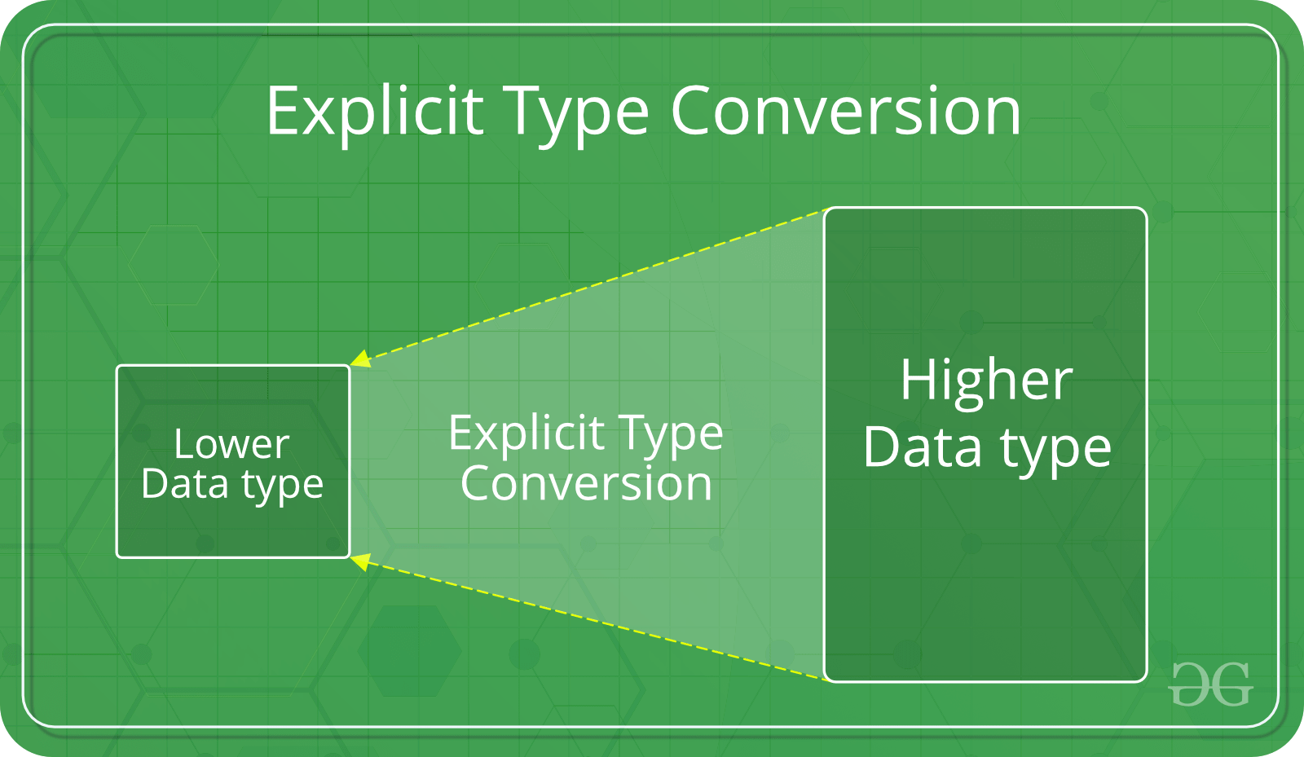
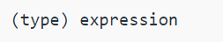
Explicit Type Conversion
Type casting, Done by programmer.
Hands-on Example…

Slide 80
Advantages & Disadvantages
Advantages of Type Conversion
Type safety: Ensure that data is being stored and processed in the correct data type, avoiding potential type mismatches and type errors.
Improved code readability: By explicitly converting data between different types.
Improved performance: In some cases, type conversions can be used to optimize the performance.
Improved data storage: Used to store data in a more compact form.
Disadvantages of type conversions
Loss of precision: A larger data type to a smaller data type can result in loss of precision, as some of the data may be truncated.
Overflow or underflow: Converting data from a smaller data type to a larger data type can result in overflow/underflow if the value being converted is too large or too small for the new data type.
Unexpected behaviour: Type conversions can lead to unexpected behaviour, such as when converting between signed and unsigned integer types, or when converting between floating-point and integer types.
Slower performance: Type conversions can sometimes result in slower performance, particularly when converting data between complex data types, such as between structures and arrays.
Improved compatibility: Used to convert data between different types that are not compatible.
Improved data manipulation: Used to manipulate data in various ways. eg. int→ string, string→ int.
Increased complexity: Type conversions can increase the complexity of your code, making it harder to debug and maintain.

Slide 81
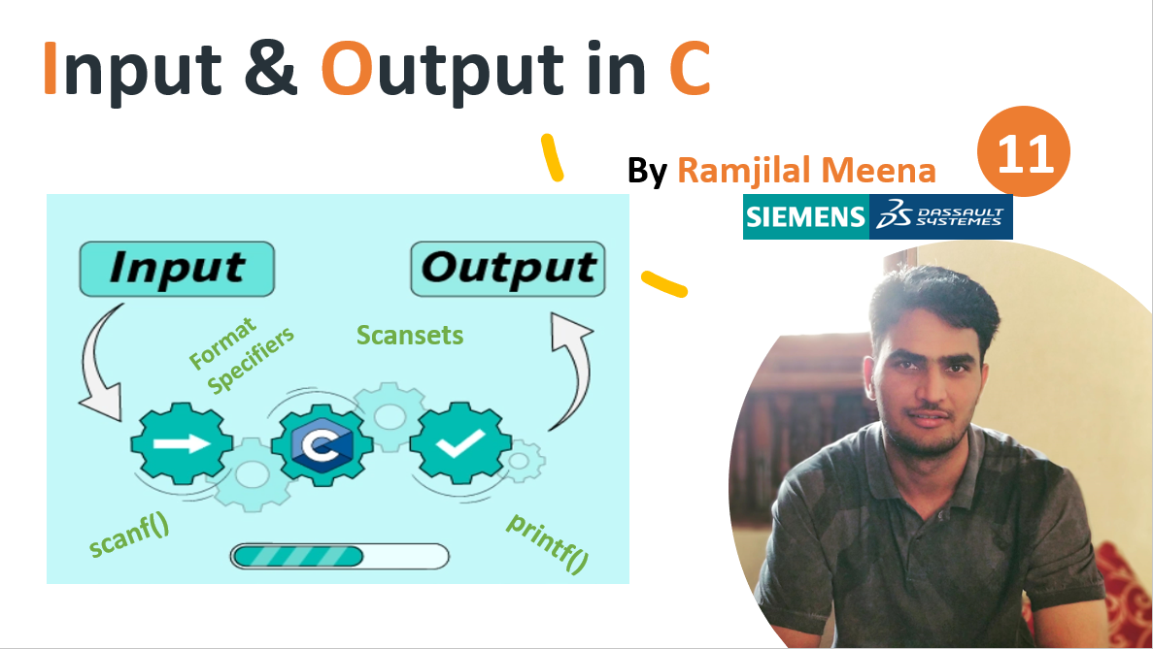
Next Video:

Slide 82
Thank You
Please Like, Subscribe and Comment.

Slide 83
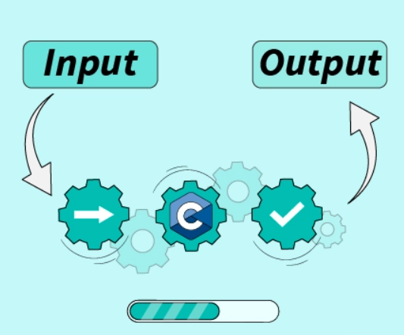
Input & Output in C
11
By Ramjilal Meena
Format Specifiers
Scansets
scanf()
printf()

Slide 84
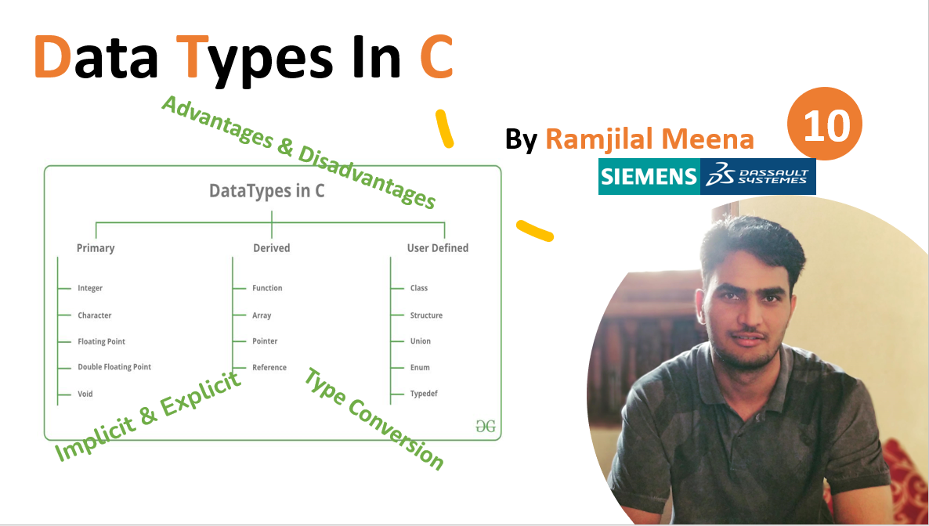
Last Videos

Slide 85
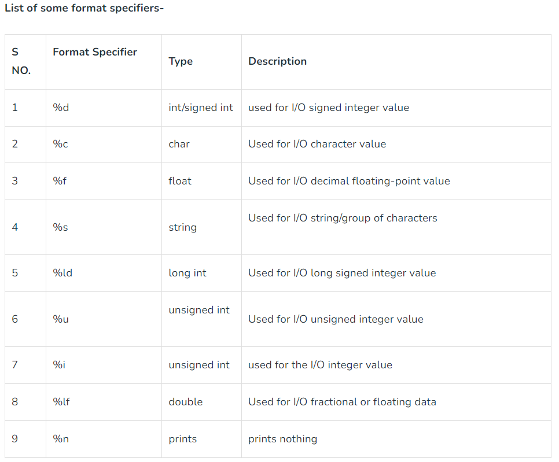
Input & Output in C
standard input output library
scanf()
scanf(“%X”, &variableOfXType);
printf()
printf(“%X”, variableOfXType);
Format Specifiers in C → %X
Scansets in C → scanf(%s[A-Z,_,a,b,c]s,str);
Hands-on Example…

Slide 86
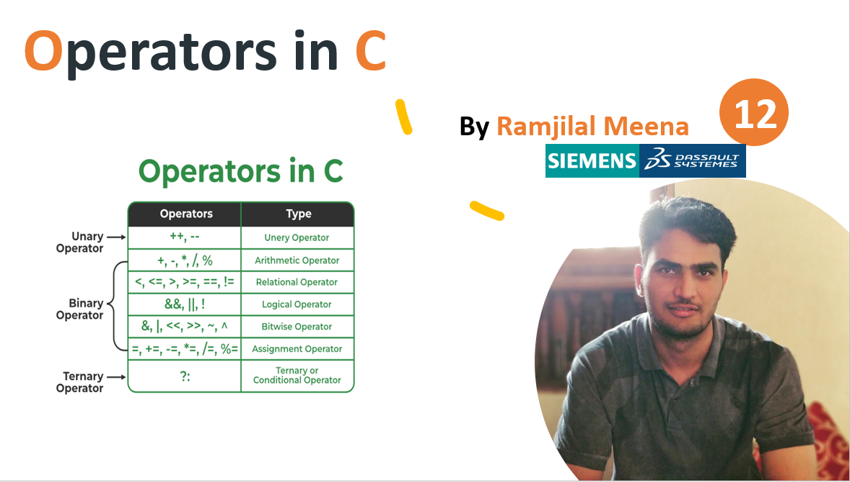
Next Video:

Slide 87
Thank You
Please Like, Subscribe and Comment.

Slide 88
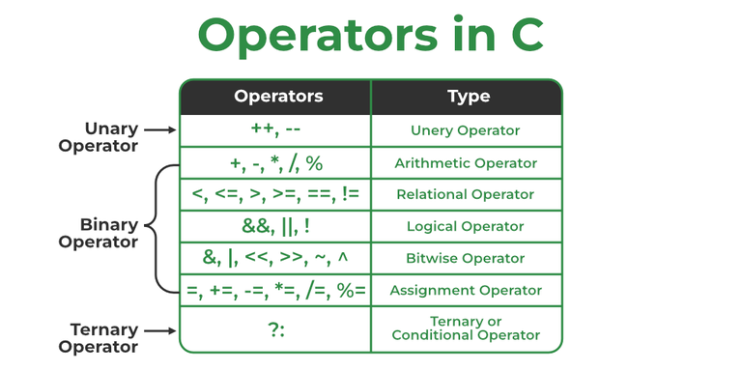
Operators in C
12
By Ramjilal Meena
Operator Precedence & Associativity

Slide 89

Last Videos

Slide 90
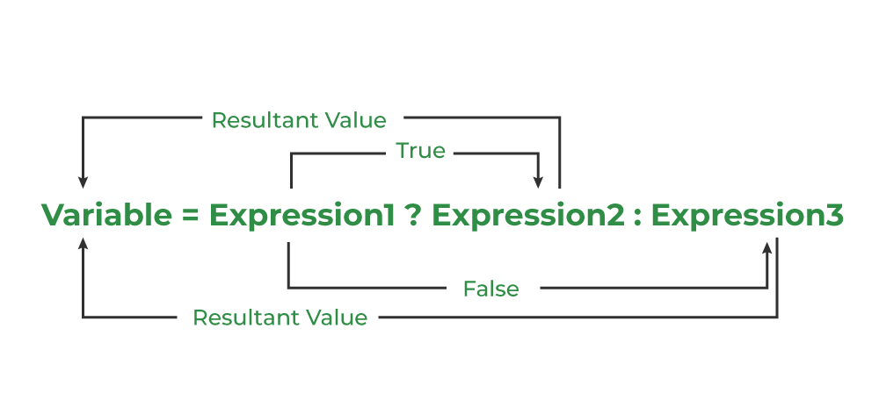
Operators in C

Slide 91

Operator Precedence & Associativity
helps in determining which operators will be given priority when there are multiple operators in the expression.
Hands-on Example…

Slide 92



Operator Precedence & Associativity

Slide 93
Understating Operators
Conclusion
Operators are symbols used for performing some kind of operation in C.
The operation can be mathematical, logical, relational, bitwise, conditional, or logical.
Types of operators → Unary, Arithmetic, Relational, Logical, Bitwise, Assignment, and Conditional operator.
Every operator returns a numerical value except logical operator which returns a Boolean value(true or false).
‘=’ and ‘==’ are not same as ‘=’ assigns the value whereas ‘==’ checks if both the values are equal or not.
There is a Precedence in the operator means the priority of using one operator is greater than another operator.

Slide 94


Next Video:

Slide 95
Thank You
Please Like, Subscribe and Comment.

Slide 96

Conditional Statements in C
13
By Ramjilal Meena
Explanations with Live Code Examples

Slide 97

Last Videos

Slide 98




Conditional Statements in C
Decision control structures
Decision-Making, whether to execute a set of statements or not.
Decide the direction of the flow of program execution.
Need of Conditional Statements?
Hands-on Example…

Slide 99




Conditional Statements in C
Hands-on Example…

Slide 100




Conditional Statements in C
range in switch → Example
Hands-on Example…

Slide 101

Next Video:

Slide 102
Thank You
Please Like, Subscribe and Comment.

Slide 103


Loops In C
14
By Ramjilal Meena

Slide 104

Last Videos

Slide 105



Loops In C
Used to repeat a block of code until the specified condition is met.
Responsible for performing repetitive tasks.

Slide 106






Loops In C
Hands-on Example…

Slide 107

Loops In C : FAQ
1. How many types of loops are there in C?
Ans: There are 3 types of loops in C language:
for Loop
while Loop
do…while Loop
2. What are the entry controlled or pre-tested loops?
Ans: The entry-controlled loops or pre-tested loops are those loops in which the loop condition is checked before executing the body of the loop.
3. What are the exit-controlled or post-tested loops?
Ans: The exit-controlled loops or post-tested loops are those loops in which the program control comes to the body of the loop before checking the loop condition.
4. Which loop is guaranteed to execute at least once?
Ans: The do…while loop is guaranteed to execute the statements in the body of the loop at least once as it is a type of exit-controlled loop.
5. Can we skip braces in C do…while loop syntax if there is only one statement in the body?
Ans: No, we cannot skip braces in C do…while syntax even if there is only a single statement unlike while and for loop.
6. How to create an infinite loop in C using the do…while loop?
Ans: We can create an infinite loop in C by specifying a condition that will always be true as the loop condition.
Hands-on Example…

Slide 108

Next Video:

Slide 109
Thank You
Please Like, Subscribe and Comment.

Slide 110


Jump Statements In C
Break Statement
15
Continue Statement
By Ramjilal Meena
goto Statement
return Statement

Slide 111
Last Videos

Slide 112





Jump Statements : break
Hands-on Example…

Slide 113


Jump Statements : continue
Hands-on Example…

Slide 114



Jump Statements : goto & return
Hands-on Example…

Slide 115

Next Video:

Slide 116
Thank You
Please Like, Subscribe and Comment.

Slide 117


Functions In C
16
By Ramjilal Meena
Explanations with Live Code Examples

Slide 118

Last Videos

Slide 119


Functions In C
A set of statements, Perform some specific task.
Provides modularity and code reusability.
Enclosed within { } braces, having certain meanings and performing certain operations.
Hands-on Example…

Slide 120


Functions : Declarations
Tells compiler about signature of the function.
The parameter name is not mandatory while declaring functions.

Slide 121

Functions : Definition
Consists of actual statements which are executed when the function is called.
A C function is generally defined and declared in a single step.

Slide 122
Functions : Call
A function call is a statement that instructs the compiler to execute the function.
Use the function name and parameters in the function call.

Slide 123



Passing Parameters to Functions
Terminology
Formal Parameter: A variable and its type as they appear in the prototype of the function.
Actual Parameter: The variable or expression corresponding to a formal parameter that appears in the function call in the calling environment.
Modes:
IN: Passes info from caller to the callee.
OUT: Callee writes values in the caller.
IN/OUT: The caller tells the callee the value of the variable,
which may be updated by the callee.
Hands-on Example…

Slide 124
Functions : Types
Advantages of C library functions
Easy to use and optimized for better performance.
Save a lot of time i.e. function development time.
Convenient as they always work.
tailor-made functions
Advantages of User-Defined Functions
Changeable functions can be modified as per need.
The Code of these functions is reusable in other programs.
These functions are easy to understand, debug and maintain.

Slide 125




Main Function
An integral part of the programming languages such as C, C++, and Java.
Entry point of a program where the execution of a program starts.
It is a user-defined function that is mandatory for the execution of a program.
Hands-on Example…

Slide 126

Predefined Identifier
__func__ → Function Name
__LINE__ → Line Number
__FILE__ → Fine Name
Hands-on Example…

Slide 127

Next Video:

Slide 128
Thank You
Please Like, Subscribe and Comment.

Slide 129
Functions In C
17
Variadic Function
By Ramjilal Meena
Parameter Vs Argument
Explanations with Live Code Examples

Slide 130
Last Video:

Slide 131


Parameter Vs Arguments In Function
Hands-on Example…

Slide 132




Variadic Function
Hands-on Example…

Slide 133


Next Video:

Slide 134
Thank You
Please Like, Subscribe and Comment.

Slide 135


Array In C Programming
18
By Ramjilal Meena

Slide 136


Last Videos

Slide 137

Array In C Programming
A fixed-size collection of similar data items stored in contiguous memory locations.
Primitive, Derived and User-defined data types can be stored.
Array of void and functions is not allowed in C

Slide 138







Types of Array in C
Single Dimensional Arrays (1D Array) →
Multidimensional Arrays
Hands-on Example…

Slide 139




Array : Declaration, Definition & Initialization
1. Array Initialization with Declaration
& Definition
2. Array Initialization with Declaration without Size
3. Array Initialization after Declaration (Using Loops)
Hands-on Example…

Slide 140




Array : Access Elements
Access Array Elements
using the array subscript operator [ ] and the index value i of the element.
Update Array Element
can update the value of an element at the given index i
using the array subscript operator [ ] and assignment operator =.
Hands-on Example…

Slide 141


Relationship between Arrays and Pointers
Arrays and Pointers are closely related
We can use pointers to perform all the possible operations of the array.
Array name is a constant pointer to the first element of the array.
Array decays to the pointers when passed to the function.
Passing & Returning an Array to/from a Function
An array is always passed as pointers.
Pass an array to a function, it decays to the pointer.
Return using a pointer to the first element of that array. (Function can only return single value)
Hands-on Example…

Slide 142
Advantages, Disadvantages and Properties
Advantages of Array
Random and fast access of elements using the array index.
Use of fewer lines of code as it creates a single array of multiple elements.
Traversal through the array becomes easy using a single loop.
Sorting becomes easy as it can be accomplished by writing fewer lines of code.
Disadvantages of Array
Allows a fixed number of elements to be entered which is decided at the time of declaration.
Insertion & deletion of elements is costly since elements are needed to be rearranged after insertion & deletion.
Properties of Arrays
Fixed Size Collection
Homogeneous Elements
Indexing in Array (0 to N-1)
Dimensions of Array
Contiguous Storage
Random Access
Array name relation with pointer
No Index Out of Bounds Checking
Array Decay

Slide 143

Length of Array
Refers to the number of elements in the array.
Used to determine the memory required to store all of its elements.
Don’t have any pre-defined function to find the length of the array.
manually determine it by using different methods mentioned below:
Using sizeof() Operator
Using Pointer Arithmetic
Using Loop
It iterates through all the elements of an array and increments the count.
Note: these methods only works when the array is declared in the same scope.

Slide 144

Next Video:

Slide 145
Thank You
Please Like, Subscribe and Comment.

Slide 146
Multidimensional Array in C
19
By Ramjilal Meena

Slide 147

Last Videos

Slide 148
Multidimensional Array in C
Hands-on Example…

Slide 149



Multidimensional Array
Array of arrays that stores homogeneous data in tabular form.
Data is generally stored in row-major order in the memory.
Left most dimensions as optional, all other dimensions must be specified.
Size of Multidimensional Arrays: (Multiply all dimensions)
The array int x[10][20] can store total (10*20) = 200 elements.
Size of array int x[10][20] = 10 * 20 * 4 = 800 bytes. (where int = 4 bytes)
Initialization of Two-Dimensional Arrays in C
Using Initializer List -
Using Loops
Hands-on Example…

Slide 150
Relationship between Arrays and Pointers
Arrays and Pointers are closely related
We can use pointers to perform all the possible operations of the array.
Array name is a constant pointer to the first element of the array.
Array decays to the pointers when passed to the function.
Passing & Returning an Array to/from a Function
An array is always passed as pointers.
Pass an array to a function, it decays to the pointer.
Return using a pointer to the first element of that array. (Function can only return single value)
Hands-on Example…

Slide 151


Jagged Array
Array of Arrays such that member arrays can be of different sizes.
Hands-on Example…

Slide 152
Array : Top Interview Questions
How to pass an array by value in C ?
Hint : Use wrapper structure.
Variable Length Arrays in C?
Hint : Use wrapper structure.
Solution (full code) → Hands-on Example…

Slide 153


Next Video:

Slide 154
Thank You
Please Like, Subscribe and Comment.

Slide 155


String In C Programming
20
By Ramjilal Meena

Slide 156

Last Videos

Slide 157


String In C
An array of characters. A sequence of characters terminated with a null character ‘\0’.
Difference between a character array and a C string is the string is terminated with a unique character ‘\0’.
C String Initialization
Assigning a string literal without size
Assigning a string literal with a predefined size (one extra character always)
Assigning character by character with size
Assigning character by character without size
Read a String Input From the User → %s
Note: When a Sequence of characters enclosed in the double quote, ‘\0’ is appended at the end of the string by default.
Note: After declaration, if we want to assign some other text to the string, we have to assign it one by one or use built-in strcpy() function because the direct assignment of string literal to character array is only possible in declaration.
Hands-on Example…

Slide 158




Array of String
Hands-on Example…

Slide 159

String.h Header file
Hands-on Example…

Slide 160


Next Video:

Slide 161
Thank You
Please Like, Subscribe and Comment.

Slide 162


Pointers In C
21
By Ramjilal Meena

Slide 163

Last Videos

Slide 164
Pointers In C
Pointers are one of the core components of the C programming language.
used to store the memory address of other variables, functions, or even other pointers.
allows low-level memory access, dynamic memory allocation.
Syntax
use the ( * ) dereferencing operator in the pointer declaration.
datatype * ptr;
Where:
ptr is the name of the pointer.
datatype is the type of data it is pointing to.

Slide 165
How to Use Pointers
Pointer Declaration → int *ptr;
Pointer Initialization → int *ptr = &var;
use the ( & ) addressof operator to get the memory address of a variable
and then store it in the pointer variable.
3. Dereferencing → int n = *ptr;
use the same ( * ) dereferencing operator that we used in the pointer declaration.
Size of Pointers
does not depend on the type it is pointing to.
depends on the operating system and CPU architecture.
The size of pointers in C is
8 bytes for a 64-bit System
4 bytes for a 32-bit System
Hands-on Example…
Hands-on Example…

Slide 166
Types of Pointers
Single Level Pointers
Multi Level Pointers
Integer Pointers → int *ptr;
Array Pointer → char *ptr = &array_name;
NULL Pointer → data_type *pointer_name = NULL;
Void Pointer (generic pointers) → void * pointer_name;
Wild Pointers → int *ptr;
Dangling Pointers → A pointer pointing to a memory
location that has been deleted (freed).
int *ptr = (int*)malloc(sizeof(int)); free(ptr);
//now ptr is dangling pointer
Pointers with constant
Constant Pointers → data_type * const pointer_name;
Pointer to Constant → const data_type * pointer_name;
Other Types of Pointers in C:
Far pointer: typically 32-bit that can access memory outside the current segment.
Huge pointer: 32-bit long containing segment address and offset address.
Complex pointer: Pointers with multiple levels of indirection.
Near pointer: used to store 16-bit addresses means within the current segment on a 16-bit machine.
Normalized pointer: It is a 32-bit pointer, which has as much of its value in the segment register as possible.
File Pointer: The pointer to a FILE data type is called a stream pointer or a file pointer.
Hands-on Example…

Slide 167
Pointers : Uses, Advantages, Disadvantages
Advantages of Pointers
Pointers are used for dynamic memory allocation and deallocation.
An Array or a structure can be accessed efficiently with pointers
Pointers are useful for accessing memory locations.
Pointers are used to form complex data structures such as linked lists, graphs, trees, etc.
Pointers reduce the length of the program and its execution time as well.
Disadvantages of Pointers
Memory corruption can occur if an incorrect value is provided to pointers.
Pointers are a little bit complex to understand.
Pointers are majorly responsible for memory leaks in C.
Pointers are comparatively slower than variables in C.
Uninitialized pointers might cause a segmentation fault.
Uses of Pointers
Pass Arguments by Reference
Accessing Array Elements
Return Multiple Values from Function
Dynamic Memory Allocation
Implementing Data Structures
In System-Level Programming where memory addresses are useful.
In locating the exact value at some memory location.
To avoid compiler confusion for the same variable name.
To use in Control Tables.

Slide 168

Next Video:

Slide 169
Thank You
Please Like, Subscribe and Comment.

Slide 170

Double Pointer & Pointer Arithmetics
22
By Ramjilal Meena

Slide 171

Last Videos

Slide 172

Double Pointer
The pointer to a pointer → used when we want to store the address of another pointer.
Declaration of Double Pointer
Application of Double Pointers in C
Used in the dynamic memory allocation of multidimensional arrays.
Used to store multilevel data such as the text document paragraph, sentences, and word semantics.
Used in data structures to directly manipulate the address of the nodes without copying.
Used as function arguments to manipulate the address stored in the local pointer.
Hands-on Example…

Slide 173




Pointer Arithmetics
These operations are:
Increment/Decrement of a Pointer
Addition/ Subtraction of integer to a pointer
Subtracting two pointers of the same type
possible only when they have the same data type.
Comparison of pointers
using comparison or relational operators on pointer variables
Hands-on Example…

Slide 174


Next Video:

Slide 175
Thank You
Please Like, Subscribe and Comment.

Slide 176


Function Pointers In C
23
By Ramjilal Meena

Slide 177

Last Videos

Slide 178



Functions Pointers Declaration & Usage
Hands-on Example…

Slide 179
Functions Pointers Interesting facts
A function pointer points to code, not data. Typically, a function pointer stores the start of executable code.
we do not allocate de-allocate memory using function pointers.
A function’s name can also be used to get functions’ address.
we can have an array of function pointers.
Function pointer can be used in place of switch case.
A function pointer can be passed as an argument and can also be returned from a function.
Hands-on Example…

Slide 180

Next Video:

Slide 181
Thank You
Please Like, Subscribe and Comment.

Slide 182


Structures In C
24
By Ramjilal Meena

Slide 183

Last Videos

Slide 184
Structures In C
A user-defined data type.
It provide a method for packing together data of different types.
It is a helpful tool to handle a group of logically related data items.
Can be used to group items of possibly different types into a single type.
struct keyword is used to define the structure.
Items in the structure are called its member & they can be of any valid data type.

Slide 185




Structures : Declaration, Definition & Access
1. C Structure Declaration
2. C Structure Definition
1. Structure Variable Declaration with Structure Template
2. Structure Variable Declaration after Structure Template
Called a structure template or structure prototype.
No memory is allocated to the structure in the declaration.
3. Access Structure Members
Using dot(.) & Arrow(->) Operators.
Hands-on Example…

Slide 186


Initialization Structure Members
Structure members cannot be initialized with the declaration.
1. Initialization using Assignment Operator
3. Initialization using Designated Initializer List
2. Initialization using Initializer List
Hands-on Example…

Slide 187



Nested Structures
C language allows us to insert one structure into another as a member.
1. Embedded Structure Nesting
2. Separate Structure Nesting
Accessing Nested Members
Hands-on Example…

Slide 188

Next Video:

Slide 189
Thank You
Please Like, Subscribe and Comment.

Slide 190





Structures In C
Part-2
25
By Ramjilal Meena
Self-Referential Structures

Slide 191
Last Video:
Declaration,, Definition & How to Access
Introduction
Initialization Structure Members
Nested Structures

Slide 192


Structure Pointer in C
We can access the members of the structure pointed by the structure pointer using the ( -> ) arrow operator.
Hands-on Example…
Self-Referential Structures

Slide 193


Structure Padding & Packing
Structure size should be the sum of the sizes of its members. But it may not be true.
Processor 32Bit → Word Size 4Byte or Processor 64Bit → Word Size 8Byte
Structure padding is the concept of adding one or more empty bytes between the different data types to align data in memory according to largest member size.
It increases memory consumption but reduces CPU read cycles.
Structure Packing is the concept to pack the structure tightly by removing the empty bytes.
C language provides two ways for structure packing:
Using #pragma pack(1)
Using __attribute((packed))__
Bit Fields are used to specify the length of the structure members in bits.
→ Hands-on Example…
→ Hands-on Example…
→ Hands-on Example…

Slide 194

Flexible Array Members in a structure
We can declare an array without a dimension and whose size is flexible in nature.
Should be declared as the last member of the structure and its size is variable(can be changed at runtime).
The structure must contain at least one more named member in addition to the flexible array member.
The flexible array member does not contribute to the size of the structure itself.
Hands-on Example…

Slide 195
Structure: Usage & Limitations
Uses of Structure in C
To define the custom data types. Examples dates, time, complex numbers, etc.
Used in data organization where a large amount of data can be stored in different fields.
To create data structures such as trees, linked lists, etc.
Can be used for returning multiple values from a function.
Limitations of C Structures
Higher Memory Consumption: It is due to structure padding.
No Data Hiding: Do not permit data hiding. Structure members can be accessed by any function, anywhere in the scope of the structure.
Functions inside Structure: Do not permit functions inside the structure so we cannot provide the associated functions.
Static Members: Cannot have static members inside its body.
Construction creation in Structure: Cannot have a constructor inside Structures.

Slide 196

Next Video:

Slide 197
Thank You
Please Like, Subscribe and Comment.

Slide 198


Unions & Bit Fields In C
26
By Ramjilal Meena

Slide 199
Last Videos

Slide 200
Unions In C
A user-defined data type.
It provides a method for packing together data of different types.
Can be used to group items of possibly different types into a single type.
Items in the union are called its member & they can be of any valid data type.
All the members in the C union are stored in the same memory location. Due to this, only one member can store data at the given instance.

Slide 201




Unions : Declaration, Definition & Access
1. C Union Declaration
2. C Union Definition
3. Access Union Members
Using dot(.) & Arrow(->) Operators.
→ where var1 is the union variable and member1 is the member of the union.
No memory is allocated to the union in the declaration.
End the union declaration with a semi-colon.

Slide 202


Initialization Unions Members
Union members cannot be initialized with the declaration.
initialization of its members by simply assigning the value to it.
only one member can contain some value at a given instance of time.
Hands-on Example…
Size of Union
Hands-on Example…

Slide 203

Difference between Structure & Union

Slide 204


Bit Fields
specify the size (in bits) of the structure and union members.
Applications of C Bit Fields
If storage is limited, we can go for bit-field.
When devices transmit status or information encoded into multiple bits for this type of situation bit-field is most efficient.
Encryption routines need to access the bits within a byte in that situation bit-field is quite useful.
Hands-on Example…

Slide 205






Interesting Facts About Bit Fields
1. A special unnamed bit field of size 0 is used to force alignment on the next boundary.
2. We cannot have pointers to bit field members as they may not start at a byte boundary.
3. It is implementation-defined to assign an out-of-range value to a bit field member.
4. Array of bit fields is not allowed.

Slide 206

Next Video:

Slide 207
Thank You
Please Like, Subscribe and Comment.

Slide 208


Enumeration & typedef In C
27
By Ramjilal Meena

Slide 209
Last Videos

Slide 210


Enumeration In C
Enumeration (or enum) is a user defined data type in C.
used to assign names to integral constants, the names make a program easy to read and maintain.
Hands-on Example…

Slide 211


Enum Initialization
1. Two enum names can have same value.
2. If we do not explicitly assign values to enum names, the compiler by default assigns values starting from 0.
3. We can assign values to some name in any order. All unassigned names get value as value of previous name plus one.
4. The value assigned to enum names must be some integral constant, i.e., the value must be in range from minimum possible integer value to maximum possible integer value.
5. All enum constants must be unique in their scope. For example, the following program fails in compilation.

Slide 212


typedef In C
The typedef is a keyword that is used to provide existing data types with a new name.
Used to redefine the name of already existing data types.
Hands-on Example…
Use of typedef in C
The typedef keyword gives a meaningful name to the existing data type which helps other users to understand the program more easily.
It can be used with structures to increase code readability and we don’t have to type struct repeatedly.
The typedef keyword can also be used with pointers to declare multiple pointers in a single statement.
It can be used with arrays to declare any number of variables.
Hands-on Example…

Slide 213

typedef In C
C typedef vs #define
#define can define aliases for values as well, for instance, you can define 1 as ONE, 3.14 as PI, etc. Typedef is limited to giving symbolic names to types only.
Preprocessors interpret #define statements, while the compiler interprets typedef statements.
No semicolon at the end of #define, but a semicolon at the end of typedef.
typedef defines a new type by copying and pasting the definition values.

Slide 214

Next Video:

Slide 215
Thank You
Please Like, Subscribe and Comment.

Slide 216

Storage Classes In C
Declaration
Definition
Properties
28
By Ramjilal Meena
Advantages & Disadvantages

Slide 217
Last Videos

Slide 218


Storage Classes
C Storage Classes are used to describe the features of a variable/function.
These features includes the storage type, initial value, scope & lifetime.
Help to trace the existence of a particular variable during the runtime of a program.
C doesn’t allow multiple storage class specifiers for a variable.
Hands-on Example…

Slide 219
Properties Storage Classes
→ auto
Default storage class for all the variables declared inside a function or a block. Hence, the keyword auto is rarely used.
Auto variables can be only accessed within the block/function ( and nested blocks) they have been declared (which defines their scope).
However, they can be accessed outside their scope as well using the pointers, with the exact memory location where the variables reside.
They are assigned a garbage value by default whenever they are declared.
→ static
Initialized only once and exist till the termination of the program. Thus, no new memory is allocated because they are not re-declared.
A static int variable remains in memory while the program is running.
Static variables are allocated memory in the data segment, not the stack segment.
Scope is local to the function to which they were defined. Global static variables can be accessed anywhere in the file.
Static variables (like global variables) are initialized as 0 if not initialized explicitly.
Static variables (like global variables) are initialized as 0 if not initialized explicitly.
Static global variables and functions are also possible in C/C++. The purpose of these is to limit the scope of a variable or function to a file.
Static variables should not be declared inside a structure.
→ register
This storage class declares register variables that have the same functionality as that of the auto variables.
Compiler tries to store these variables in the register of the microprocessor if a free register is available.
Much faster than that of the variables stored in the memory during the runtime of the program.
register can only be used within a block (local), it can not be used in the global scope (outside main).
There is no limit on the number of register variables, but the point is compiler may put some variables in the register and some not.
Hands-on Example…
Hands-on Example…

Slide 220
Properties Storage Classes
→ extern
When we write extern some_data_type some_variable_name; no memory is allocated. Only the property of the variable is announced.
When an extern variable is initialized, then memory for this is allocated and it will be considered defined.
A variable or function can be declared any number of times, but it can be defined only once. (Remember the basic principle that you can’t have two locations of the same variable or function).
The extern variable says to the compiler “Go outside my scope and you will find the definition of the variable that I declared.”
The compiler believes that whatever that extern variable said is true and produces no error. Linker throws an error when it finds no such variable exists.
The extern keyword is used to extend the visibility of variables/functions.
Since functions are visible throughout the program by default, the use of the extern is not needed in function declarations or definitions. Its use is implicit.
Hands-on Example…

Slide 221

Next Video:

Slide 222
Thank You
Please Like, Subscribe and Comment.

Slide 223

Memory Layout of C Programs
Memory Allocation
Memory Deallocation
Memory Leak
29
By Ramjilal Meena

Slide 224
Last Videos

Slide 225
Memory Layout of C Programs
Text Segment:
known as a code segment, is one of the sections of a program in an object file or in memory, which contains executable instructions.
Placed below the heap or stack to prevent heaps and stack overflows from overwriting it.
Sharable so that only a single copy needs to be in memory for frequently executed programs, such as text editors, the C compiler, the shells, and so on.
Read-only, to prevent a program from accidentally modifying its instructions.
Initialized Data Segment:
contains the global variables and static variables that are initialized by the programmer.
not read-only, since the values of the variables can be altered at run time.
It can be further classified into the initialized read-only area and the initialized read-write area.
global char s[] = “hello world” and global int debug=1 → initialized read-write area.
global const char* str = “hello world” makes the string literal “hello world” to be stored in the initialized read-only area and the character pointer variable str in the initialized read-write area.
Ex: static int i = 10 and global int i = 10 will be stored in data segment
Uninitialized Data Segment:
often called the “bss” segment → “block started by symbol.”
Data in this segment is initialized by the kernel to arithmetic 0, which do not have explicit initialization in source code.
Ex. Global static int I and global int j; would be contained in the BSS segment.

Slide 226
Memory Layout of C Programs
Stack:
The stack area traditionally adjoined the heap area and grew in the opposite direction.
when the stack pointer met the heap pointer, free memory was exhausted. (With modern large address spaces and virtual memory techniques they may be placed almost anywhere, but they still typically grow in opposite directions.)
The stack area contains the program stack, a LIFO structure, typically located in the higher parts of memory.
A “stack pointer” register tracks the top of the stack; it is adjusted each time a value is “pushed” onto the stack.
The set of values pushed for one function call is termed a “stack frame”. It consists a return address and address of automatic variables.
Heap:
Heap is the segment where dynamic memory allocation usually takes place.
The heap area begins at the end of the BSS segment and grows to larger addresses from there.
The Heap area is managed by malloc, realloc, and free, which may use the brk and sbrk system calls to adjust its size.

Slide 227




Memory Layout
1. Check the following simple C program
2. Let us add one global variable in the program, now check the size of bss

Slide 228




Memory Layout
3. Let us add one local static variable which is also stored in bss.
4. Let us initialize the static variable which will then be stored in the Data Segment (DS)

Slide 229


Memory Layout
5. Let us initialize the global variable which will then be stored in the Data Segment (DS)

Slide 230

Next Video:

Slide 231
Thank You
Please
Like
Subscribe
Comment

Slide 232
Dynamic Memory Allocation
30
By Ramjilal Meena
Malloc()
Calloc()
Realloc()
Free()
Memory Allocation
Memory Deallocation
Memory Leak

Slide 233
Last Videos

Slide 234

Dynamic Memory Allocation
There are 4 library functions in <stdlib.h> header file to facilitate dynamic memory allocation.
malloc() → memory allocation
used to dynamically allocate a single large block of memory with the specified size.
It returns a pointer of type void which can be cast into a pointer of any form.
It doesn’t Initialize memory so initially each block contains the default garbage value.
If space is insufficient, allocation fails and returns a NULL pointer.
Hands-on Example…

Slide 235

Dynamic Memory Allocation
calloc() → contiguous allocation
used to dynamically allocate the specified number of blocks of memory of the specified type.
It initializes each block with a default value ‘0’.
It has two parameters or arguments as compare to malloc().
If space is insufficient, allocation fails and returns a NULL pointer.
Hands-on Example…

Slide 236


Dynamic Memory Allocation
realloc() → re-allocation
used to dynamically change the memory allocation of a previously allocated memory.
if the memory previously allocated with the help of malloc or calloc is insufficient, realloc can be used to dynamically re-allocate memory.
If space is insufficient, allocation fails and returns a NULL pointer.
re-allocation of memory maintains the already present value and new blocks will be initialized with the default garbage value.
Hands-on Example…

Slide 237

Dynamic Memory Allocation
free() → memory de-allocation
used to dynamically de-allocate the memory.
The memory allocated using functions malloc() and calloc() is not de-allocated on their own.
It helps to reduce wastage of memory by freeing it.
Hands-on Example…

Slide 238


Memory Leak & How to avoid
Memory leak occurs when programmers create a memory in a heap and forget to delete it.
To avoid memory leaks, memory allocated on the heap should always be freed when no longer needed.
The consequence of the memory leak
Reduces the performance of the computer by reducing the amount of available memory.
Too much of the available memory may become allocated and all or part of the system or device stops working correctly, the application fails, or the system slows down vastly.

Slide 239




How to dynamically allocate a 2D array
1) Using a single pointer and a 1D array with pointer arithmetic
2) Using an array of pointers
3) Using pointer to a pointer
4) …..
Hands-on Example…

Slide 240

Dynamically Growing Array in C
A Dynamically Growing Array is a type of dynamic array, which can automatically grow in size to store data.
C language only has static arrays whose size should be known at compile time & cannot be changed after declaration.
Basic Principle
Array should allow the users to allocate memory at runtime and also change the allocated size afterward.
Working
The initial size of the newly created array would be small.
Different functions would provide all the basic operations that a conventional array provides.
When the array runs out of space, the capacity would be doubled by using realloc() to reallocate the array.
After we have done our task involving the array, clear the memory using free().
Hands-on Example…

Slide 241

Dynamically Growing Array in C
Components of Dynamically Growing Array
dynamic_array: The base structure for the dynamically growing array.
arrayInit(): This function is to initialize the array.
deleteArr(): This function is for freeing the memory once we are done with the array.
Basic Operations
insertItem(): For inserting an element at the end of the array
getItem(): For retrieving the element at the given index
updateItem(): For updating an element at that given index of the array
printItem(): For printing all the elements of the array
deleteItem(): For deleting an element of the array at the given index
Hands-on Example…

Slide 242

Next Video:

Slide 243

Thank You
Please
Like
Subscribe
Comment

Slide 244


Preprocessors In C
31
Macros
File Inclusion
By Ramjilal Meena

Slide 245









C Preprocessors
Preprocessor is a programs that process the source code before compilation.
Doesn’t know about the scope rules. program’s block structure is irrelevant.
Preprocessor directives come into effect as soon as they are seen and remain in effect until the end of the file that contains them
Preprocessor Directives
Tells the compiler to preprocess the source code before compiling.
All these preprocessor directives begin with a ‘#’ (hash) symbol.
The ‘#’ symbol indicates that whatever statement starts with a ‘#’ will go to the preprocessor program to get executed.
Can be placed anywhere in the program.
Types of Preprocessor Directives:
Macros
File Inclusion
Conditional Compilation
Other directives
→ standard directory
→ source file’s directory.
Hands-on Example…

Slide 246
Preprocessor Directives
Preprocessor Directives | Description
#define | Used to define a macro
#undef | Used to undefine a macro
#include | Used to include a file in the source code program
#ifdef | Used to include a section of code if a certain macro is defined by #define
#ifndef | Used to include a section of code if a certain macro is not defined by #define
#if | Check for the specified condition
#else | Alternate code that executes when #if fails
#endif | Used to mark the end of #if, #ifdef, and #ifndef

Slide 247
Advantages & disadvantages of Macros
Advantages of Macros
Increased productivity: Macros can save time and reduce errors by automating repetitive tasks.
Customization: Macros can be customized to fit specific needs, allowing for greater flexibility in how tasks are completed.
Consistency: Macros can help ensure consistency in tasks by following a set of predetermined instructions.
Efficiency: Macros can perform tasks more quickly than humans, improving overall efficiency.
Ease of use: Macros are easy to create and use, requiring little to no programming knowledge.
Automate tasks, simplify complex processes, and improve productivity.
Disadvantages of Macros
Security risks: Macros can be a security risk if they are not properly secured or if they are used to execute malicious code.
Limited functionality: Macros may not be able to perform more complex tasks, limiting their usefulness.
Compatibility issues: Macros may not be compatible with all software applications, limiting their usefulness.
Maintenance: Macros may require maintenance and updates, which can be time-consuming and costly.
Dependence: Over-reliance on macros can result in decreased problem-solving skills and critical thinking.

Slide 248
How to write your own header file?
The files with .h extension are called header files in C
Header files generally contain definitions of data types, function prototypes and C preprocessor commands.
Important Points:
The header files are needed generally while writing large C programs so that the modules can share the function definitions, prototypes etc.
Function and type declarations, global variables, structure declarations and in some cases, inline functions definitions which need to be centralized in one file.
In a header file, do not use redundant or other header files, only minimal set of statements.
Don’t put function definitions in a header. Put these things in a separate .c file.
Include Declarations for functions and variables whose definitions will be visible to the linker. Also, definitions of data structures and enumerations that are shared among multiple source files.
In short, Put only what is necessary and keep the header file concised.
Hands-on Example…

Slide 249

typedef Vs #define
typedef is limited to giving symbolic names to types only, whereas #define can be used to define an alias for values as well, e.g., you can define 1 as ONE, 3.14 as PI, etc.
typedef interpretation is performed by the compiler where #define statements are performed by preprocessor.
#define should not be terminated with a semicolon, but typedef should be terminated with semicolon.
#define will just copy-paste the definition values at the point of use, while typedef is the actual definition of a new type.
typedef follows the scope rule which means if a new type is defined in a scope (inside a function), then the new type name will only be visible till the scope is there. In case of #define, when preprocessor encounters #define, it replaces all the occurrences, after that (No scope rule is followed).
Hands-on Example…

Slide 250
Thank You
Please
Like
Subscribe
Comment

Slide 251


File Handling In C
32
By Ramjilal Meena
Reading
Writing
Closing

Slide 252

File Handling
The process → create, open, read, write, & close operations on a file.
C functions → fopen(), fwrite(), fread(), fseek(), fprintf(), etc.
Why do we need File Handling in C?
to store the information fetched from the program
In order to understand why file handling is important, let us look at a few features of using files:
Reusability: The data stored in the file can be accessed, updated, and deleted anywhere and anytime providing high reusability.
Portability: Without losing any data, files can be transferred to another in the computer system. The risk of flawed coding is minimized with this feature.
Efficient: A large amount of input may be required for some programs. File handling allows you to easily access a part of a file using few instructions which saves a lot of time and reduces the chance of errors.
Storage Capacity: Files allow you to store a large amount of data without having to worry about storing everything simultaneously in a program.
Hands-on Example…

Slide 253

Types of Files in C?
Text/other Files
Contains data in the form of ASCII characters and is generally used to store a stream of characters.
Each line in a text file ends with a new line character (‘\n’).
It can be read or written by any text editor.
They are generally stored with .txt file extension.
Text files can also be used to store the source code.
Binary Files
Contains data in binary form (i.e. 0’s and 1’s) instead of ASCII characters. They contain data that is stored in a similar manner, like it is stored in the main memory.
The binary files can be created only from a program and their contents can only be read by a program.
More secure as they are not easily readable.
They are generally stored with .bin file extension.

Slide 254

File Operations & Modes
Opening Modes | Description
r/rb | Search, Open & loads it into memory & sets up a pointer that to the first character in it, else returns NULL
w/wb | Open/create file in write mode. Overwrite if file exists. Returns NULL, if unable to open/create the file.
a | Open/create file in append mode. Append input if file exists. Returns NULL, if unable to open/create.
a+ | Open/create file in both reading and append mode. Append input if file exists. Returns NULL, if unable
r+ | Open/create file in both read and write mode. Insert data at the start if file exists. Returns NULL, if unable
wb+ | Open for both reading and writing in binary mode. If the file exists, its contents are overwritten. If the file does not exist, it will be created.
w+ | Searches file. If the file exists, its contents are overwritten. If the file doesn’t exist a new file is created. Returns NULL, if unable to open the file.
rb+ | Open for both reading and writing in binary mode. If the file does not exist, fopen( ) returns NULL.
ab | Open for append in binary mode. Data is added to the end of the file. If the file does not exist, it will be created.
ab+ | Open for both reading and appending in binary mode. If the file does not exist, it will be created.

Slide 255





File Handling
Reading From a File
Write to a File
Closing a File →
Hands-on Example…

Slide 256

File Handling
Functions | Description
fopen() | It is used to create a file or to open a file.
fclose() | It is used to close a file.
fgets() | It is used to read a file.
fprintf() | It is used to write blocks of data into a file.
fscanf() | It is used to read blocks of data from a file.
getc() | It is used to read a single character to a file.
putc() | It is used to write a single character to a file.
fseek() | It is used to set the position of a file pointer to a mentioned location.
ftell() | It is used to return the current position of a file pointer.
rewind() | It is used to set the file pointer to the beginning of a file.
putw() | It is used to write an integer to a file.
getw() | It is used to read an integer from a file.

Slide 257
Thank You
Please
Like
Subscribe
Comment

Slide 258

Miscellaneous In
Part-1
33
time.h header file
By Ramjilal Meena
Multi-Threading
Multi-Processing Fork() & wait()
Signals, Signal Handlers
Socket Programming
Input-output system calls | Create, Open, Close, Read, Write

Slide 259

Data Types in time.h
contains definitions of functions to get and manipulate date and time information.
It describes three time-related data types.
clock_t → represents the processor time in terms of the number of CPU cycles passed since the start of the process.
time_t → represents the clock time as an integer which is a part of the calendar time.
struct tm → holds the date and time which contains:
It also contains CLOCKS_PER_SEC macro which holds the number of times does the system clock ticks per second.
Hands-on Example…

Slide 260
Pre-defined functions in time.h
Function Name | Explanation
asctime() | Takes struct tm as a parameter & Returns the date and time in the string format day month date hours:minutes:seconds year. E.g.: Sat Jul 27 11:26:03 2019.
clock() | This function returns the processor time consumed by a program
ctime() | This function takes time_t as parameter & returns the date and time in the format day month hours:minutes:seconds year. E.g.: Sat Jul 27 11:26:03 2019
difftime() | This function returns the difference between the times provided.
gmtime() | This function prints the UTC (Coordinated Universal Time) Time and date. Format for both gmtime() and asctime() is same
mktime() | This function returns the calendar-time equivalent using struct tm.
time() | This function returns the calendar-time(Seconds since January 1, 1970) equivalent using data-type time_t.
strftime() | This function helps to format the string returned by other time functions using different format specifiers
Hands-on Example…

Slide 261
Thank You
Please
Like
Subscribe
Comment

Slide 262
Miscellaneous In
Part-2
34
time.h header file
By Ramjilal Meena
Multi-Threading
Multi-Processing Fork() & wait()
Signals, Signal Handlers
Socket Programming
Input-output system calls | Create, Open, Close, Read, Write

Slide 263

Multi-Threading In C
What is a Thread?
A thread is a single sequence stream within a process.
threads have some of the properties of processes, called lightweight processes.
What are the differences between process and thread?
Threads are not independent from each other unlike processes.
Because, threads shares with other threads their code section, data section and OS resources like open files and signals.
But like processes, a thread has its own program counter (PC), a register set, stack space
Why Multithreading?
Threads are popular way to improve application through parallelism. For example, in a browser, multiple tabs can be different threads. MS word uses multiple threads.
Threads operate faster than processes due to following reasons:
Thread creation is much faster.
Context switching between threads is much faster.
Threads can be terminated easily
Communication between threads is faster.

Slide 264
Thank You
Please
Like
Subscribe
Comment

Slide 265
Miscellaneous In
Part-3
35
time.h header file
By Ramjilal Meena
Multi-Threading
Multi-Processing Fork() & wait()
Signals, Signal Handlers
Socket Programming
Input-output system calls | Create, Open, Close, Read, Write

Slide 266

fork() System calls in C
The Fork system call is used for creating a new process in Linux systems, which runs concurrently with the process that makes the fork() call (parent process).
After a new child process is created, both processes will execute the next instruction following the fork() system call.
The child process uses the same pc(program counter), same CPU registers, and same open files which use in the parent process.
Processes does not share the code section, data section.
It takes no parameters and returns an integer value.
Negative Value: The creation of a child process was unsuccessful.
Zero: Returned to the newly created child process.
Positive value: Returned to parent or caller. The value contains the process ID of the newly created child process.
Hands-on Example…→

Slide 267


Wait() System calls in C
A call to wait() blocks the calling process until one of its child processes exits or a signal is received. After child process terminates, parent continues its execution after wait system call instruction.
Child process may terminate due to any of these:
It calls exit();
It returns (an int) from main
It receives a signal (from the OS or another process) whose default action is to terminate.
If any process has more than one child processes, then after calling wait(), parent process has to be in wait state if no child terminates. If only one child process is terminated, then return a wait() returns process ID of the terminated child process.
If more than one child processes are terminated than wait() reap any arbitrarily child and return a process ID of that child process.
If any process has no child process, then wait() returns immediately “-1”.
Hands-on Example…→

Slide 268
Thank You
Please
Like
Subscribe
Comment

Slide 269
Miscellaneous In
Part-4
36
time.h header file
By Ramjilal Meena
Multi-Threading
Multi-Processing Fork() & wait()
Signals, Signal Handlers
Socket Programming
Input-output system calls | Create, Open, Close, Read, Write

Slide 270


Signals In C
A signal is a software generated interrupt that is sent to a process by the OS
Fix set of signals that can be sent to a process.
Signal are identified by integers.
Signal number have symbolic names.
OS Structure for Signals
For each process, the operating system maintains 2 integers with the bits corresponding to a signal numbers.
The two integers keep track of: pending signals and blocked signals
With 32-bit integers, up to 32 different signals can be represented.

Slide 271

Signal Handlers
Default Signal Handlers
User Defined Signal Handlers
The default handler routines actions:
Ign: Ignore the signal, do nothing, just return
Term: terminate the process
Cont: unblock a stopped process
Stop: block the process
Hands-on Example…

Slide 272
Thank You
Please
Like
Subscribe
Comment

Slide 273

Miscellaneous In
Part-5
37
time.h header file
By Ramjilal Meena
Multi-Threading
Multi-Processing Fork() & wait()
Signals, Signal Handlers
Socket Programming
Input-output system calls | Create, Open, Close, Read, Write

Slide 274

Socket Programming in C
What is socket programming?
Socket programming is a way of connecting two nodes on a network to communicate with each other.
One socket(node) listens on a particular port at an IP.
The other socket reaches out to the other to form a connection.
The server forms the listener socket.
The client reaches out to the server.

Slide 275
Stages for server process
Socket creation: int sockfd = socket(domain, type, protocol)
sockfd: socket descriptor, an integer (like a file-handle)
domain: integer, specifies communication domain.
AF_ LOCAL for communication between processes on the same host.
AF_INET for communication between processes on different hosts connected by IPV4.
type: communication type SOCK_STREAM: TCP(reliable, connection oriented) SOCK_DGRAM: UDP(unreliable, connectionless)
protocol: Protocol value for Internet Protocol(IP), which is 0.
Setsockopt: int setsockopt(int sockfd, int level, int optname, const void *optval, socklen_t optlen)
Bind: int bind(int sockfd, const struct sockaddr *addr, socklen_t addrlen);
Binds the socket to the address & port number. E.g. bind the server to the localhost.
Listen: int listen(int sockfd, int backlog);
It puts the server socket in a passive mode, where it waits for the client to approach the server to make a connection.
The backlog, defines the maximum backlog queue length.
Accept:
int new_socket= accept(int sockfd, struct sockaddr *addr, socklen_t *addrlen);
Extracts the first connection request from pending connections queue.
Creates a new connected socket.
The connection is established between client and server.
They are ready to transfer data.

Slide 276
Stages for client process
Socket connection:
Exactly same as that of server’s socket creation
Connect: int connect(int sockfd, const struct sockaddr *addr, socklen_t addrlen);
Connects the socket referred to by the file descriptor sockfd to the address specified by addr.
Server’s address and port is specified in addr.

Slide 277
Thank You
Please
Like
Subscribe
Comment

Slide 278
Miscellaneous In
Part-6
38
time.h header file
By Ramjilal Meena
Multi-Threading
Multi-Processing Fork() & wait()
Signals, Signal Handlers
Socket Programming
Input-output system calls | Create, Open, Close, Read, Write

Slide 279
Input-output system calls | Create, Open, Close, Read, Write
Flags | Description
O_RDONLY | Opens the file in read-only mode.
O_WRONLY | Opens the file in write-only mode.
O_RDWR | Opens the file in read and write mode.
O_CREAT | Create a file if it doesn’t exist.
O_EXCL | Prevent creation if it already exists.
O_ APPEND | Opens the file and places the cursor at the end of the contents.
O_ASYNC | Enable input and output control by signal.
O_CLOEXEC | Enable close-on-exec mode on the open file.
O_NONBLOCK | Disables blocking of the file opened.
O_TMPFILE | Create an unnamed temporary file at the specified path.
Calls that a program makes to the system kernel to provide the services to which the program does not have direct access.
For example, providing access to input and output devices such as monitors and keyboards.
We can use various functions provided in the C Programming language for input/output system calls such as create, open, read, write, etc.
Hands-on Example…

Slide 280


Input-output system calls | Create, Open, Close, Read, Write
Important Terminology
File Descriptor : The file descriptor is an integer that uniquely identifies an open file of the process.
File Descriptor table: A file descriptor table is the collection of integer array indices that are file descriptors in which elements are pointers to file table entries. One unique file descriptors table is provided in the operating system for each process.
File Table Entry: File table entries are a structure In-memory surrogate for an open file, which is created when processing a request to open the file and these entries maintain file position.
Standard File Descriptors: When any process starts, then that process file descriptors table’s fd(file descriptor) 0, 1, 2 open automatically, (By default) each of these 3 fd references file table entry for a file named /dev/tty
/dev/tty: In-memory surrogate for the terminal.
Terminal: Combination keyboard/video screen.
Read from stdin => read from fd 0: Whenever we write any character from the keyboard, it reads from stdin through fd 0 and saves to a file named /dev/tty.
Write to stdout => write to fd 1: Whenever we see any output to the video screen, it’s from the file named /dev/tty and written to stdout in screen through fd 1.
Write to stderr => write to fd 2: We see any error to the video screen, it is also from that file write to stderr in screen through fd 2.

Slide 281
Input-output system calls | Create, Open, Close, Read, Write
int create(char *filename, mode_t mode);
int open (const char* Path, int flags);
Parameter
filename: name of the file which you want to create
mode: indicates permissions of the new file.
Return Value
return first unused file descriptor (generally 3 when first creating use in the process because 0, 1, 2 fd are reserved (stdin, stdout, and stderr))
return -1 when an error
Parameters
Path: Path to the file which we want to open.
flags: specify how you want to open the file.
Return Value
return first unused file descriptor
return -1 when an error
<unistd.h> & <fcntl.h>
How C open() works in OS
Find the existing file on the disk.
Create file table entry.
Set the first unused file descriptor to point to the file table entry.
Return file descriptor used, -1 upon failure.
How C create() works in OS
Create a new empty file on the disk.
Create file table entry.
Set the first unused file descriptor to point to the file table entry.
Return file descriptor used, -1 upon failure.
Note:- when the main process is created, then fd 0, 1, 2 are already taken by stdin, stdout, and stderr. So the first unused file descriptor is 3 in the file descriptor table. After that in close() system call is free it these 3 file descriptors and then set 3 file descriptors as null. So when we called the second open(), then the first unused fd is also 3.
Hands-on Example…

Slide 282
Input-output system calls | Create, Open, Close, Read, Write
int close(int fd);
size_t read (int fd, void* buf, size_t cnt);
Parameter
fd: File descriptor of the file that you want to close.
Return Value
0 on success.
-1 on error.
Important Points
buf needs to point to a valid memory location with a length not smaller than the specified size because of overflow.
fd should be a valid file descriptor returned from open() to perform the read operation because if fd is NULL then the read should generate an error.
cnt is the requested number of bytes read, while the return value is the actual number of bytes read. Also, sometimes read system call should read fewer bytes than cnt.
How C close() works in the OS
Destroy file table entry referenced by element fd of the file descriptor table – As long as no other process is pointing to it!
Set element fd of file descriptor table to NULL
Parameters
fd: file descriptor of the file from which data is to be read.
buf: buffer to read data from
cnt: length of the buffer
Return Value
return Number of bytes read on success
return 0 on reaching the end of file
return -1 on error
return -1 on signal interrupt
Hands-on Example…

Slide 283
Input-output system calls | Create, Open, Close, Read, Write
size_t write (int fd, void* buf, size_t cnt);
Important Points about C write
The file needs to be opened for write operations
buf needs to be at least as long as specified by cnt because if buf size is less than the cnt then buf will lead to the overflow condition.
cnt is the requested number of bytes to write, while the return value is the actual number of bytes written. This happens when fd has a less number of bytes to write than cnt.
If write() is interrupted by a signal, the effect is one of the following:
If write() has not written any data yet, it returns -1 and sets errno to EINTR.
If write() has successfully written some data, it returns the number of bytes it wrote before it was interrupted.
Parameters
fd: file descriptor
buf: buffer to write data to.
cnt: length of the buffer.
Return Value
returns the number of bytes written on success.
return 0 on reaching the End of File.
return -1 on error.
return -1 on signal interrupts.
Hands-on Example…

Slide 284
Thank You
Please
Like
Subscribe
Comment

Slide 285
Video Topics
Library? , What is library?, How to make library? User defined library?

Slide 286
Next slide
Hands-on Example…

Slide 287
Volatile qualifier in C

